Slide 1
Introduction: numerical sets, functions, limits

Slide 2
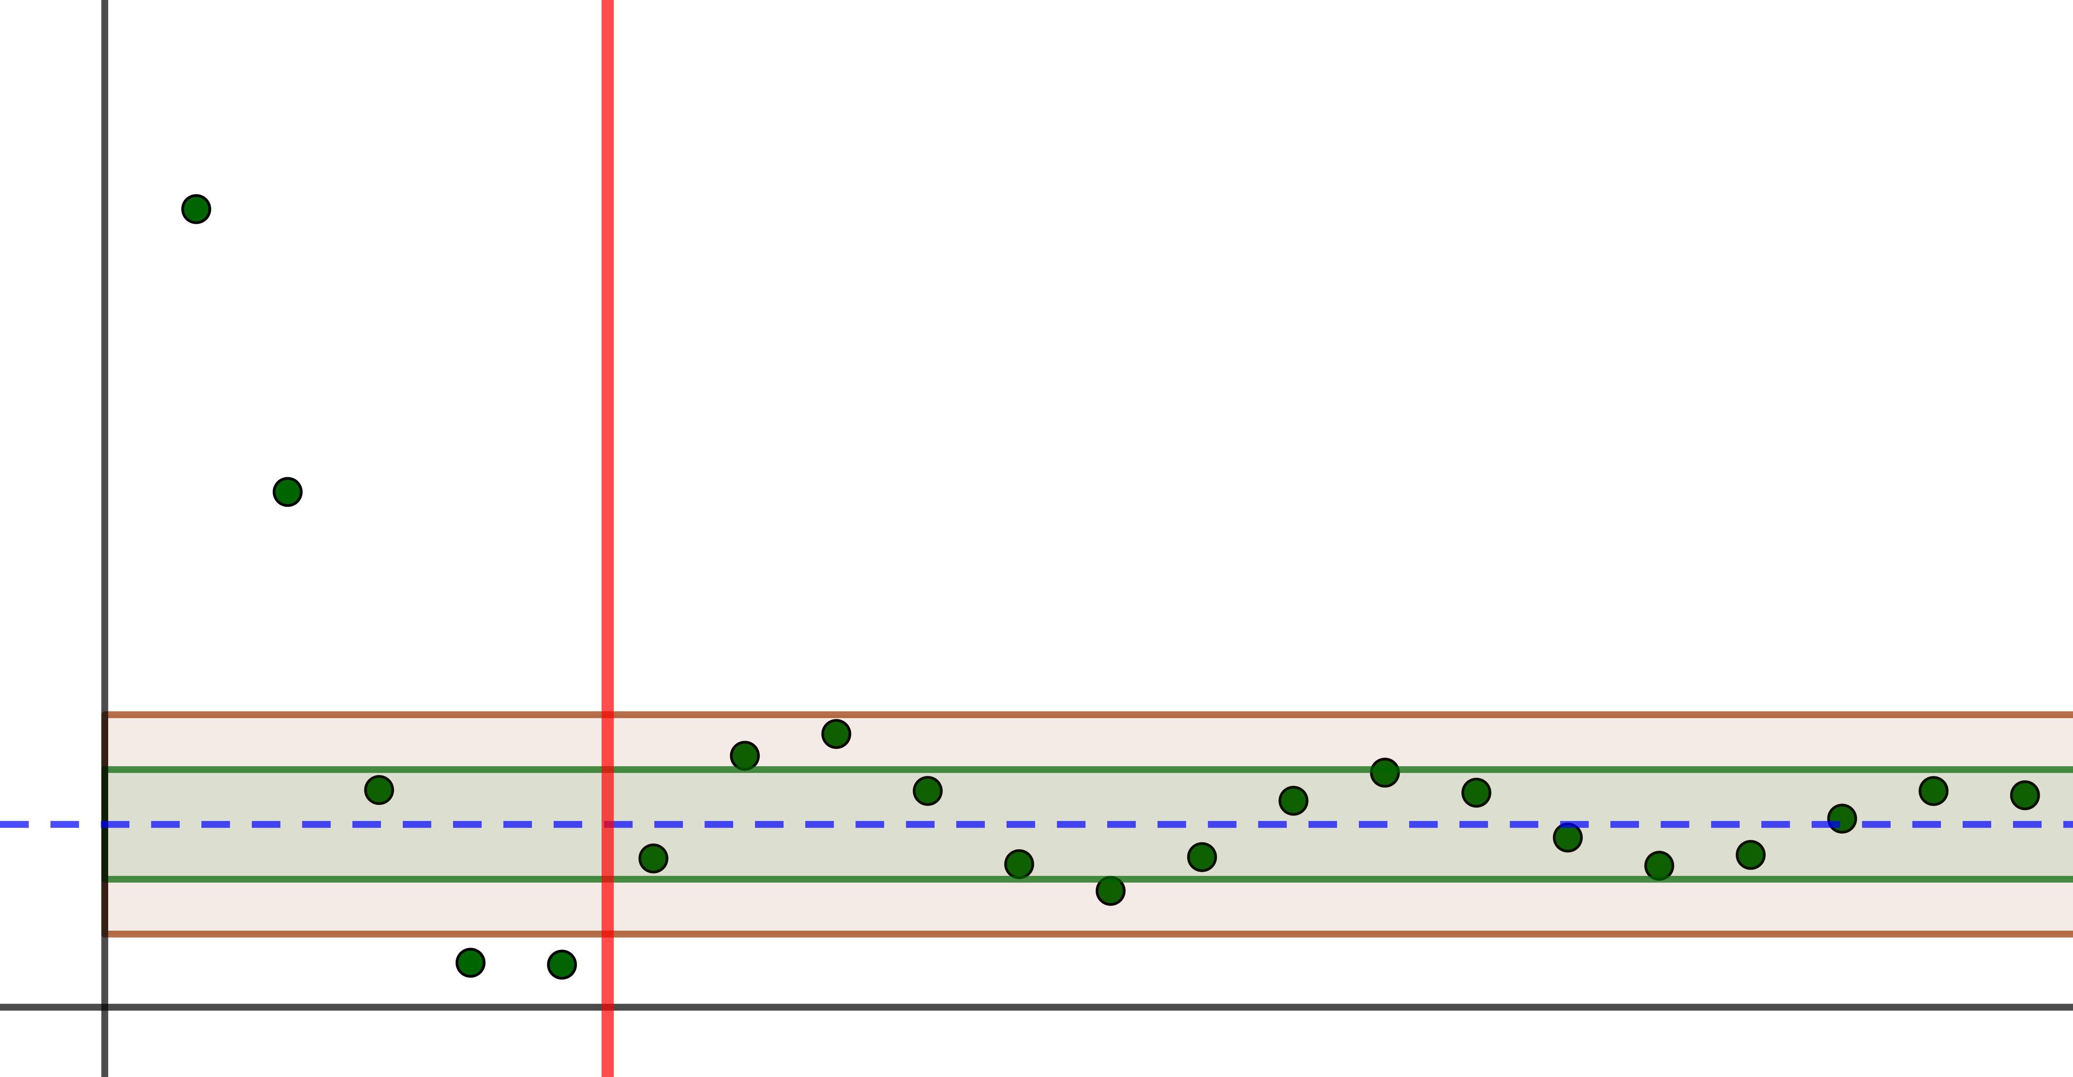
Introduction
We need to define some basic terms we are working with, such as numerical set, mapping and function
What is function’s graph and how to get one through transitions of know graph?
How to properly define sequences and its limits?

Slide 3
Numerical sets

Slide 4
Introduction: numerical sets
Normally we treat various process in real life and mathematics as functions of one or several variables.
In order to properly define firstly we all need to agree on two basic concepts: set and mapping.

Slide 5
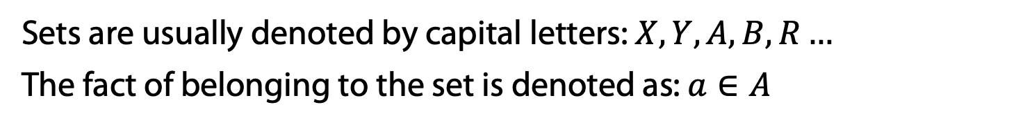
Introduction: numerical sets
Normally we treat various process in real life and mathematics as functions of one or several variables.
In order to properly define firstly we all need to agree on two basic concepts: set and mapping.
A set (is commonly called non-definable and fundamental) is an entity, a collection of some objects:
An object either belongs to the set or do not
One object could be included in the set only one time
There is no order (even if it is trivial) on objects of the set
X
a
c
b
Sets are usually denoted by capital letters: $X, Y, A, B, R…$
The fact of belonging to the set is denoted as: $a∈A$

Slide 6
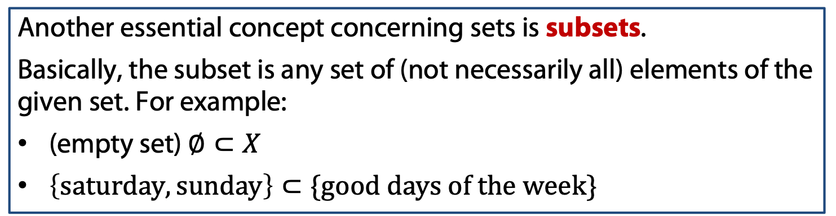
Introduction: numerical sets
Another essential concept concerning sets is subsets.
Basically, the subset is any set of (not necessarily all) elements of the given set. For example:
(empty set) $∅⊂X$
$\left\{saturday, sunday\right\}⊂\{good days of the week\}$

Slide 7
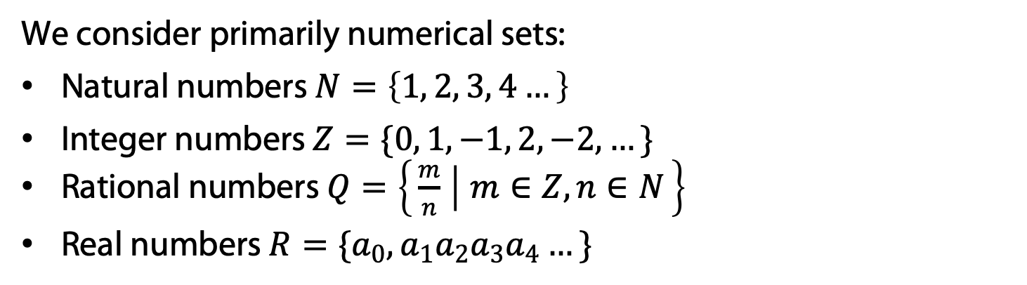
Introduction: numerical sets
Another essential concept concerning sets is subsets.
Basically, the subset is any set of (not necessarily all) elements of the given set. For example:
(empty set) $∅⊂X$
$\left\{saturday, sunday\right\}⊂\{good days of the week\}$
We consider primarily numerical sets:
Natural numbers $N=\left\{1, 2, 3, 4…\right\}$
Integer numbers $Z=\{0, 1, −1, 2, −2, …\}$
Rational numbers $Q=\left\{\frac{m}{n} ∣ m∈Z, n∈N\right\}$
Real numbers $R=\{a_{0},a_{1}a_{2}a_{3}a_{4}…\}$

Slide 8

Introduction: numerical sets
Another essential concept concerning sets is subsets.
Basically, the subset is any set of (not necessarily all) elements of the given set. For example:
(empty set) $∅⊂X$
$\left\{saturday, sunday\right\}⊂\{good days of the week\}$
We consider primarily numerical sets:
Natural numbers $N=\left\{1, 2, 3, 4…\right\}$
Integer numbers $Z=\{0, 1, −1, 2, −2, …\}$
Rational numbers $Q=\left\{\frac{m}{n} ∣ m∈Z, n∈N\right\}$
Real numbers $R=\{a_{0},a_{1}a_{2}a_{3}a_{4}…\}$
Example: prove that $\sqrt{2}$ is not rational.

Slide 9
Mappings and quantifiers

Slide 10
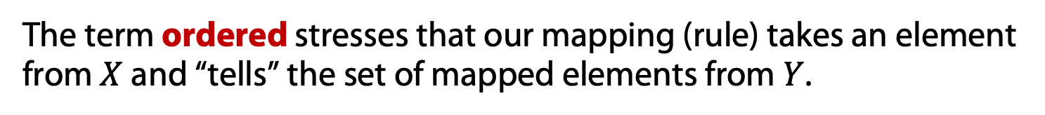
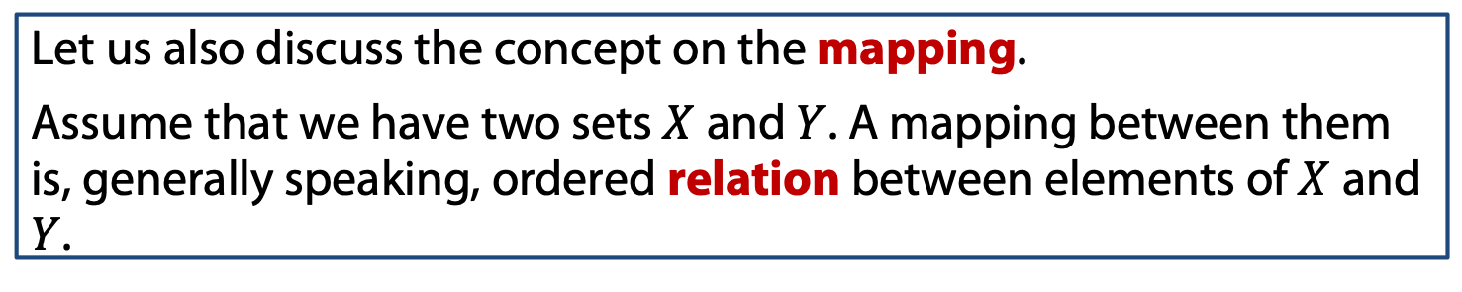
Introduction: mappings and quantifiers
Let us also discuss the concept on the mapping.
Assume that we have two sets $X$ and $Y$. A mapping between them is, generally speaking, ordered relation between elements of $X$ and $Y$.
X
Y
The term ordered stresses that our mapping (rule) takes an element from $X$ and “tells” the set of mapped elements from $Y$.

Slide 11
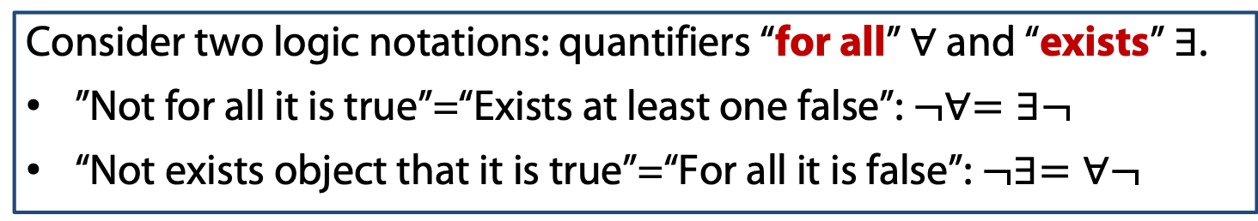
Introduction: mappings and quantifiers
Let us also discuss the concept on the mapping.
Assume that we have two sets $X$ and $Y$. A mapping between them is, generally speaking, ordered relation between elements of $X$ and $Y$.
X
Y
The term ordered stresses that our mapping (rule) takes an element from $X$ and “tells” the set of mapped elements from $Y$.
Consider two logic notations: quantifiers “for all” $∀$ and “exists” $∃$.
”Not for all it is true”=“Exists at least one false”: $¬∀=∃¬$
“Not exists object that it is true”=“For all it is false”: $¬∃=∀¬$

Slide 12
Functions: definitions

Slide 13
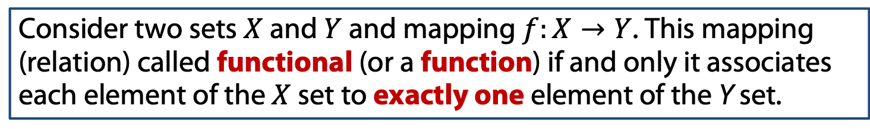
Functions: definitions
Consider two sets $X$ and $Y$ and mapping $f:X→Y$. This mapping (relation) called functional (or a function) if and only it associates each element of the $X$ set to exactly one element of the Y set.
X
f
Y
Domain
Set of arguments
Codomain
Set of values

Slide 14
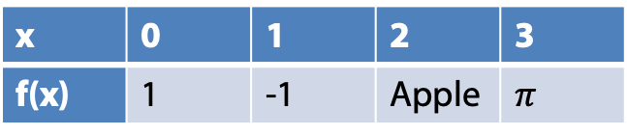
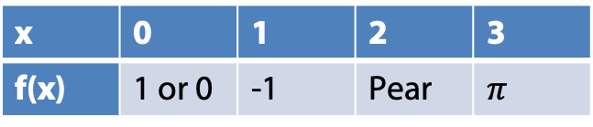
Functions: definitions
Consider two sets $X$ and $Y$ and mapping $f:X→Y$. This mapping (relation) called functional (or a function) if and only it associates each element of the $X$ set to exactly one element of the Y set.
X
f
Y
Domain
Set of arguments
Codomain
Set of values
Compare this to tables: one corresponds to the functional relation, whilst other is not.
x | 0 | 1 | 2 | 3
f(x) | 1 | -1 | Apple | $π$
x | 0 | 1 | 2 | 3
f(x) | 1 or 0 | -1 | Pear | $π$

Slide 15
Functions: definitions
Ways to describe a function:
Table of values;
Algebraic (by formula);
Graphical

Slide 16
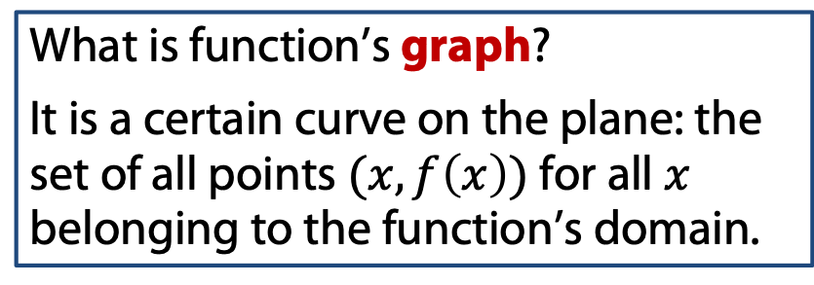
Functions: definitions
Ways to describe a function:
Table of values;
Algebraic (by formula);
Graphical
What is function’s graph?
It is a certain curve on the plane: the set of all points $(x,f\left(x\right))$ for all $x$ belonging to the function’s domain.

Slide 17
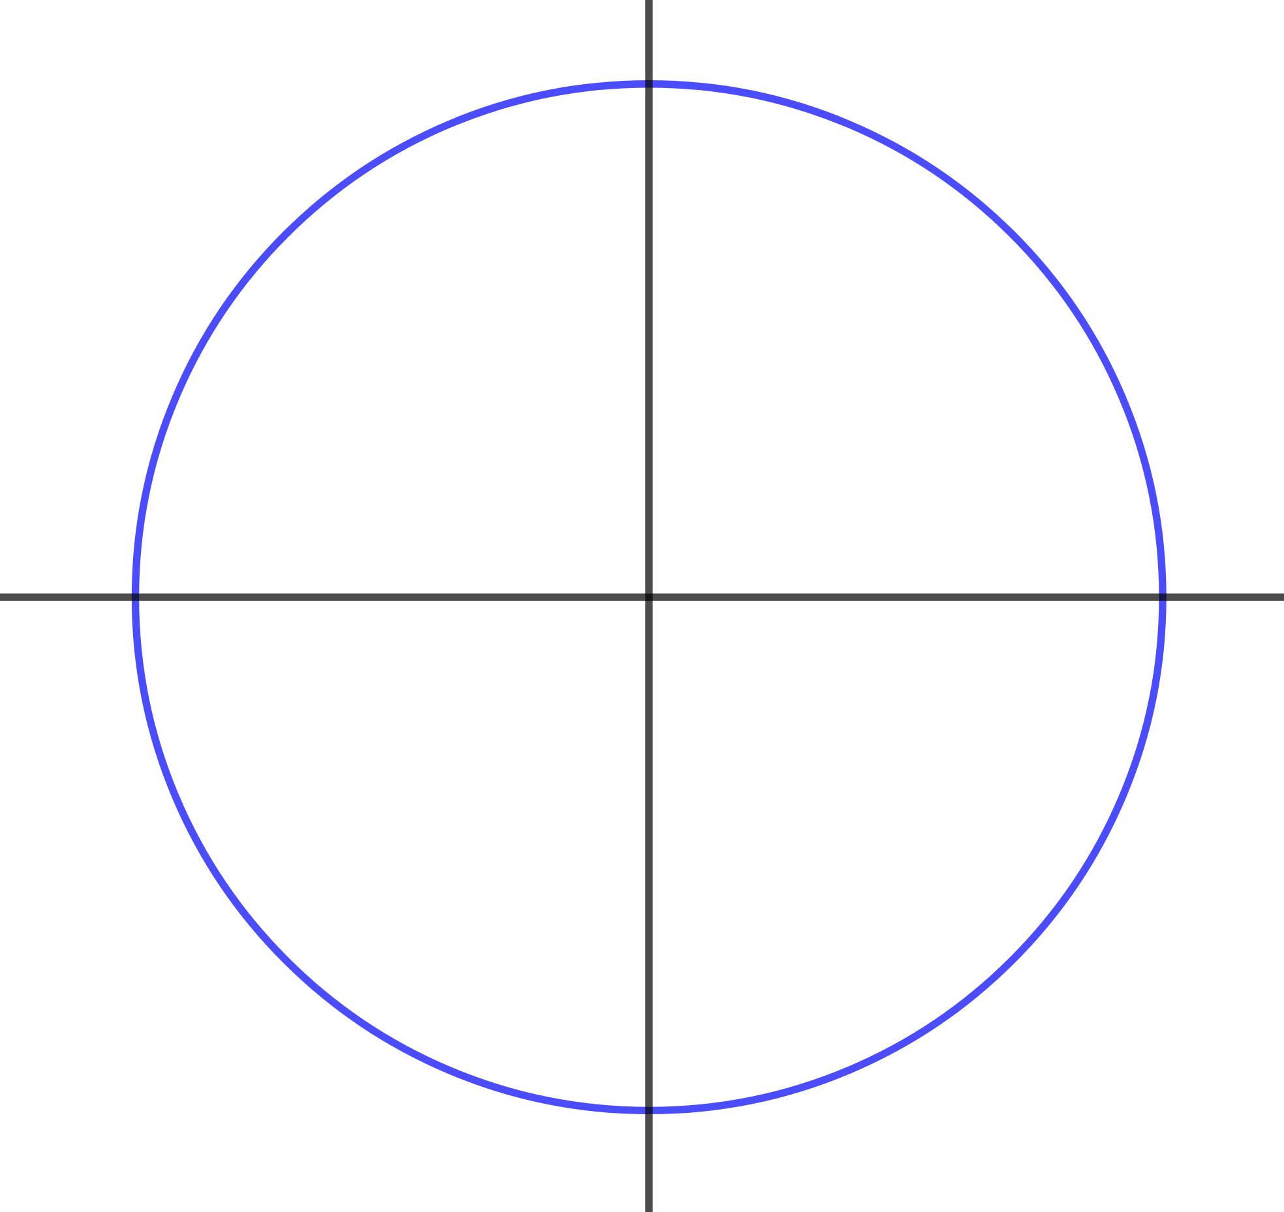
Functions: definitions
Ways to describe a function:
Table of values;
Algebraic (by formula);
Graphical
What is function’s graph?
It is a certain curve on the plane: the set of all points $(x,f\left(x\right))$ for all $x$ belonging to the function’s domain.
Example: could this plot be a function’s plot?

Slide 18
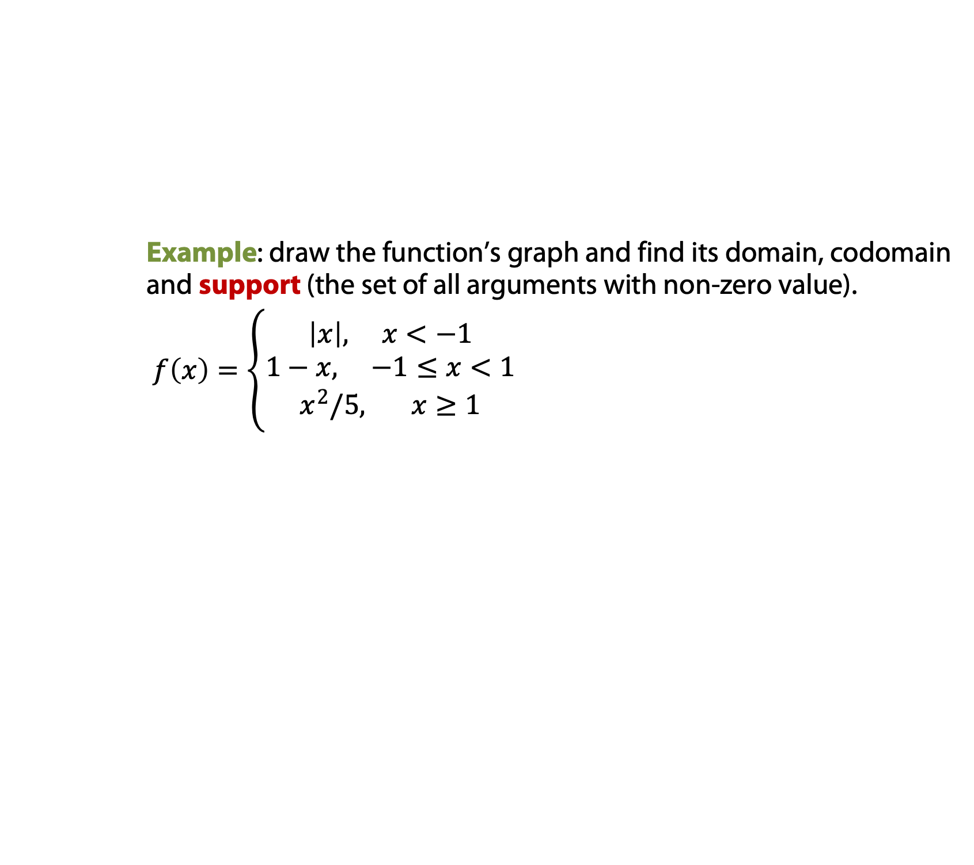
Functions: definitions
Ways to describe a function:
Table of values;
Algebraic (by formula);
Graphical
What is function’s graph?
It is a certain curve on the plane: the set of all points $(x,f\left(x\right))$ for all $x$ belonging to the function’s domain.
Example: draw the function’s graph and find its domain, codomain and support (the set of all arguments with non-zero value).
$f\left(x\right)=\left\{\begin{aligned}\left|x\right|, x<−1 \\ 1−x, −1≤x<1 \\ x^{2}/5, x≥1\end{aligned}\right.$

Slide 19
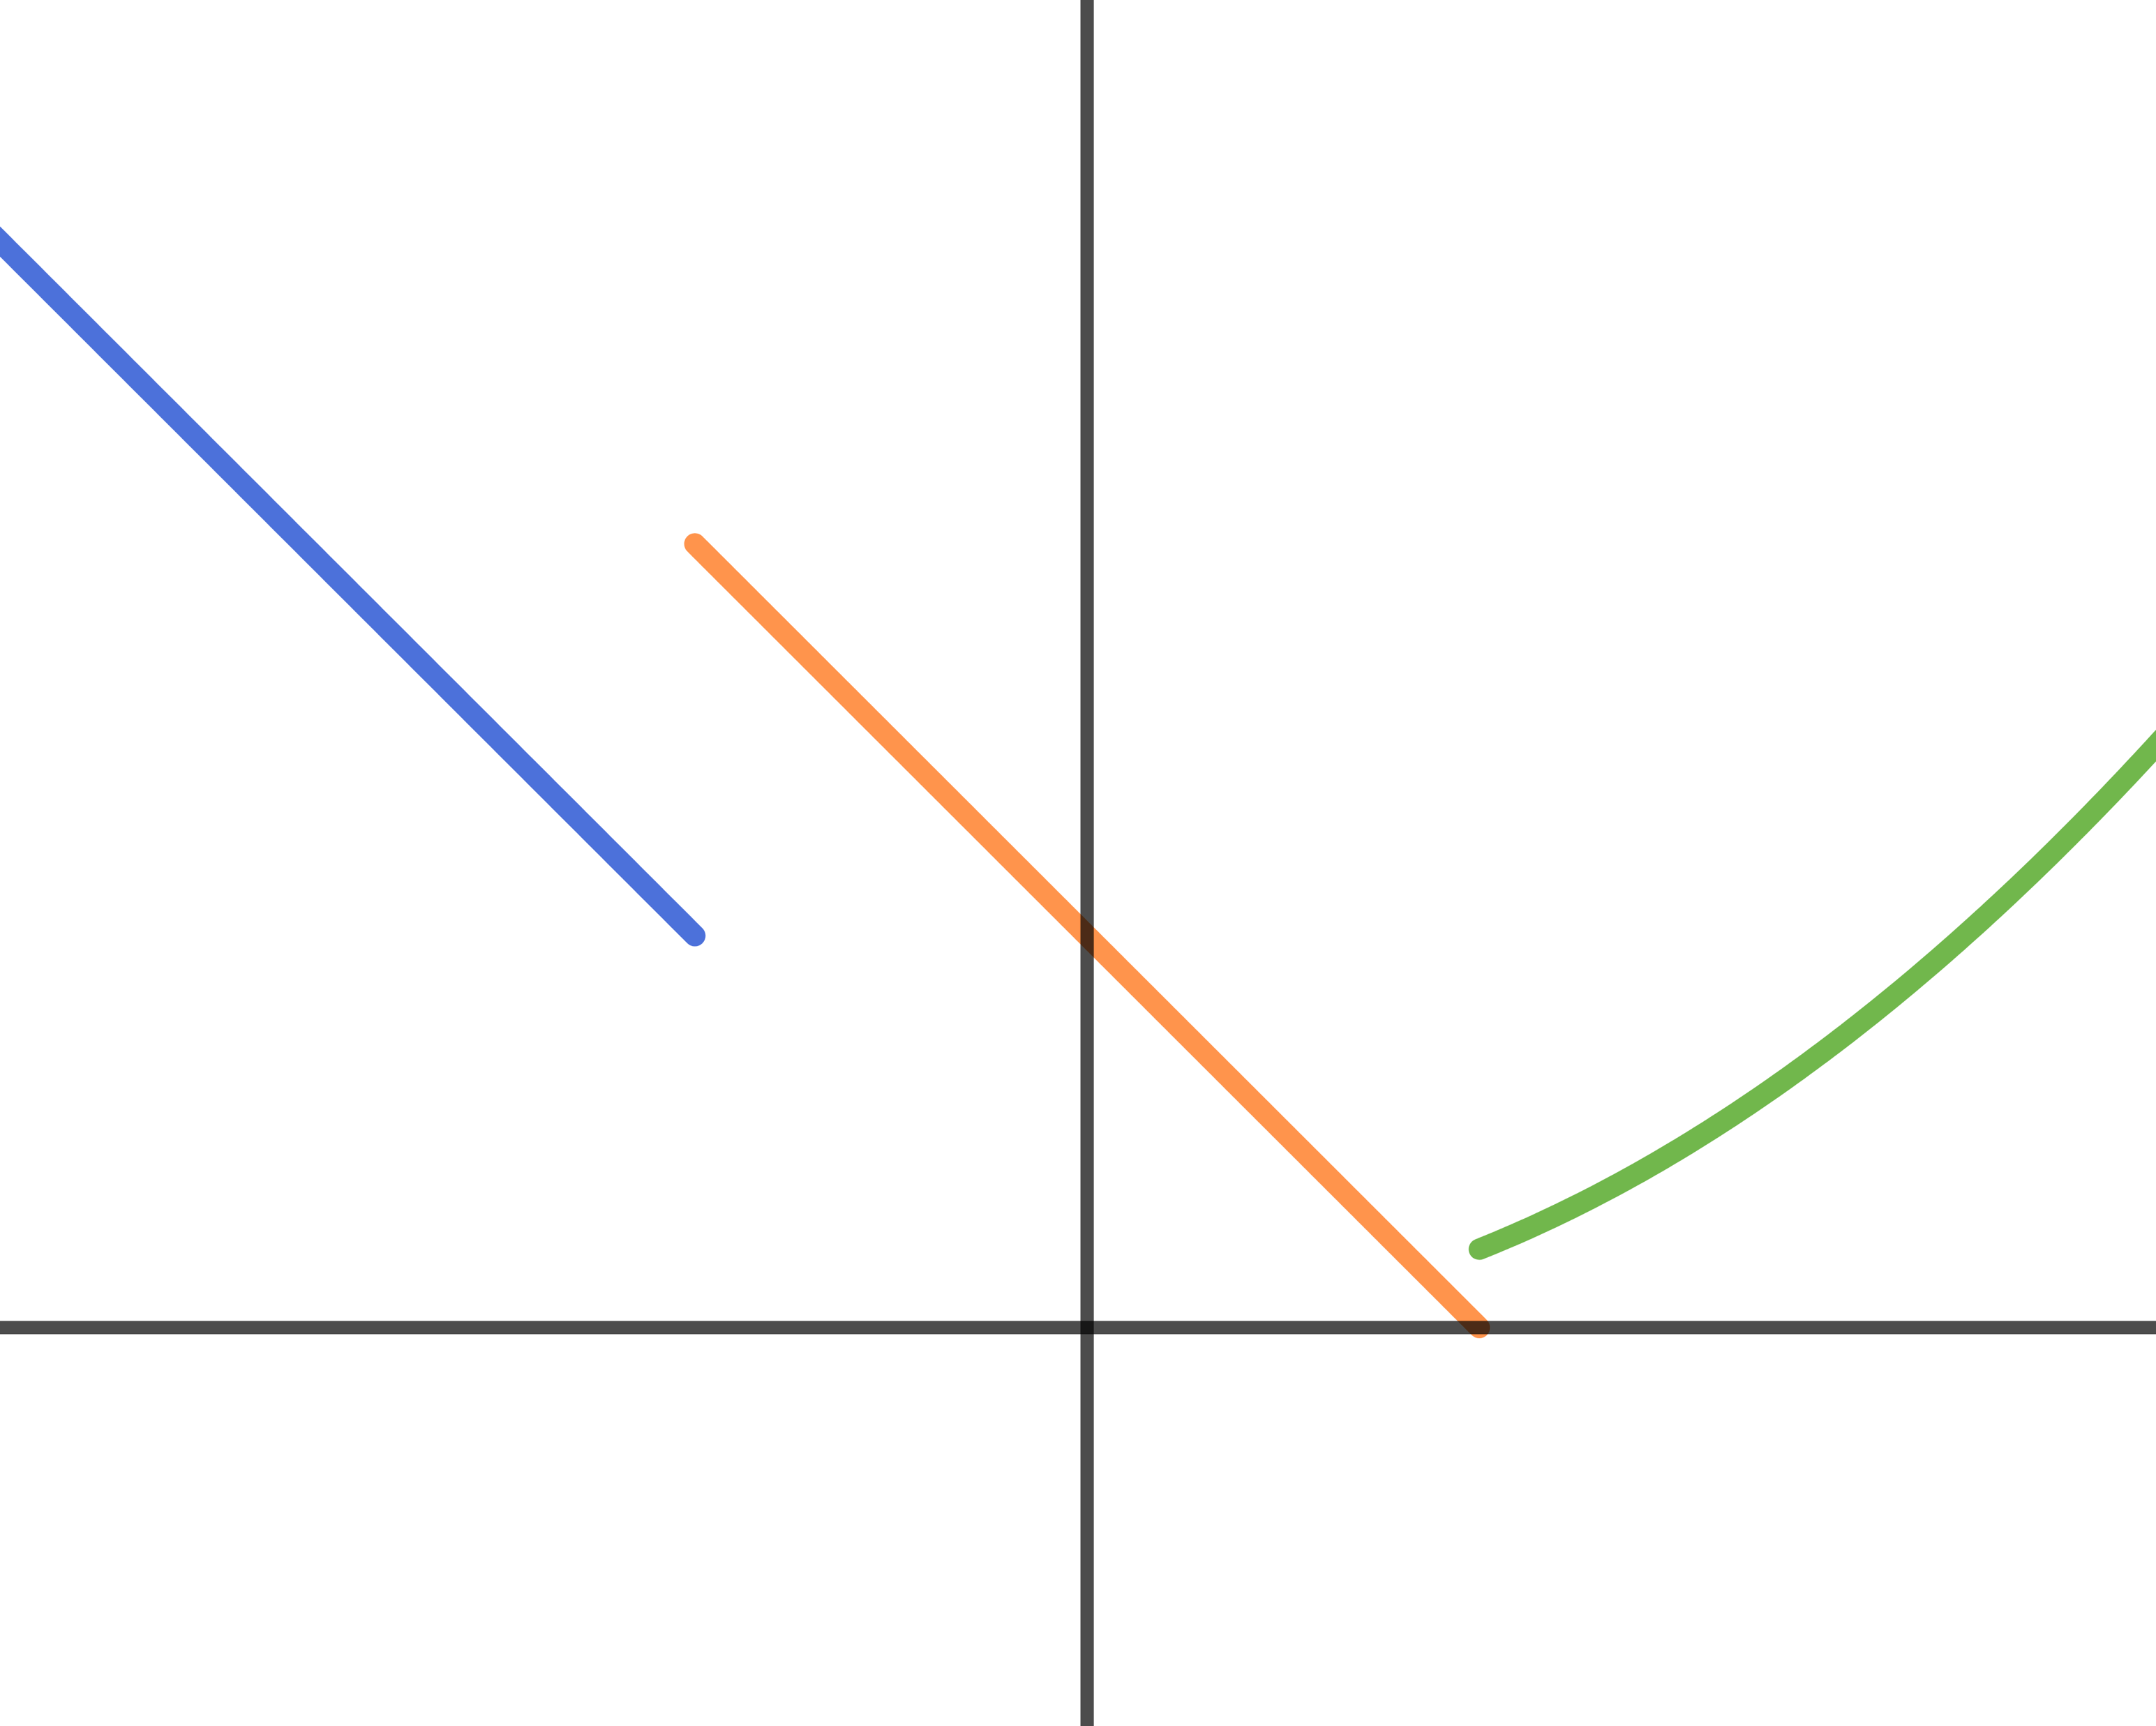
Functions: definitions
Ways to describe a function:
Table of values;
Algebraic (by formula);
Graphical
What is function’s graph?
It is a certain curve on the plane: the set of all points $(x,f\left(x\right))$ for all $x$ belonging to the function’s domain.
Example: draw the function’s graph and find its domain, codomain and support (the set of all arguments with non-zero value).
$f\left(x\right)=\left\{\begin{aligned}\left|x\right|, x<−1 \\ 1−x, −1≤x<1 \\ x^{2}/5, x≥1\end{aligned}\right.$

Slide 20
Functions: arithmetic and composition

Slide 21
Functions: arithmetic and composition
In most cases when we think about algebraically defined functions, we actually think about elementary functions.
To properly define this class, we need to understand two things: its basic units and allowed operations.

Slide 22
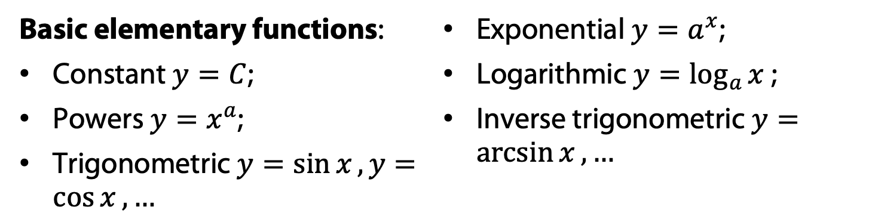
Functions: arithmetic and composition
In most cases when we think about algebraically defined functions, we actually think about elementary functions.
To properly define this class, we need to understand two things: its basic units and allowed operations.
Basic elementary functions:
Constant $y=C$;
Powers $y=x^{a}$;
Trigonometric $y=\sin{x}, y=\cos{x}, …$
Exponential $y=a^{x}$;
Logarithmic $y=\log_{a}{x }$;
Inverse trigonometric $y=\arcsin{x}, …$

Slide 23
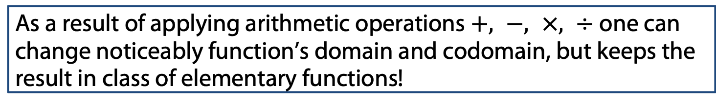
Functions: arithmetic and composition
In most cases when we think about algebraically defined functions, we actually think about elementary functions.
To properly define this class, we need to understand two things: its basic units and allowed operations.
Basic elementary functions:
Constant $y=C$;
Powers $y=x^{a}$;
Trigonometric $y=\sin{x}, y=\cos{x}, …$
Exponential $y=a^{x}$;
Logarithmic $y=\log_{a}{x }$;
Inverse trigonometric $y=\arcsin{x}, …$
As a result of applying arithmetic operations $+, −, ×, ÷$ one can change noticeably function’s domain and codomain, but keeps the result in class of elementary functions!
Example: $P_{n}\left(x\right)=a_{0}+a_{1}x+a_{2}x^{2}+a_{3}x^{3}+…+a_{n}x^{n}$

Slide 24
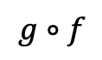


Functions: arithmetic and composition
Consider the following relation between sets and functions:
$$f:X→Y and g:Y→Z$$
X
Y
Z
f
g
$$g∘f$$
The result of consequent application of functions $f$ and $g$ is called a composite function or a composition $g∘f$ or $g(f\left(x\right))$.

Slide 25
Functions: arithmetic and composition
Consider the following relation between sets and functions:
$$f:X→Y and g:Y→Z$$
X
Y
Z
f
g
$$g∘f$$
The result of consequent application of functions $f$ and $g$ is called a composite function or a composition $g∘f$ or $g(f\left(x\right))$.
The order of composition is crucially important!
Example:

Slide 26
Graph transformations

Slide 27
Functions: graph transformations
Since we defined basic elementary functions, their graphs are considerably widely known. In the same time, the graph of an arbitrary elementary function is a comprehensive objects and plotting it remains challenging.
Still in certain cases we may get the graph of non-basic function by subsequently applying simple transformation to it.

Slide 28
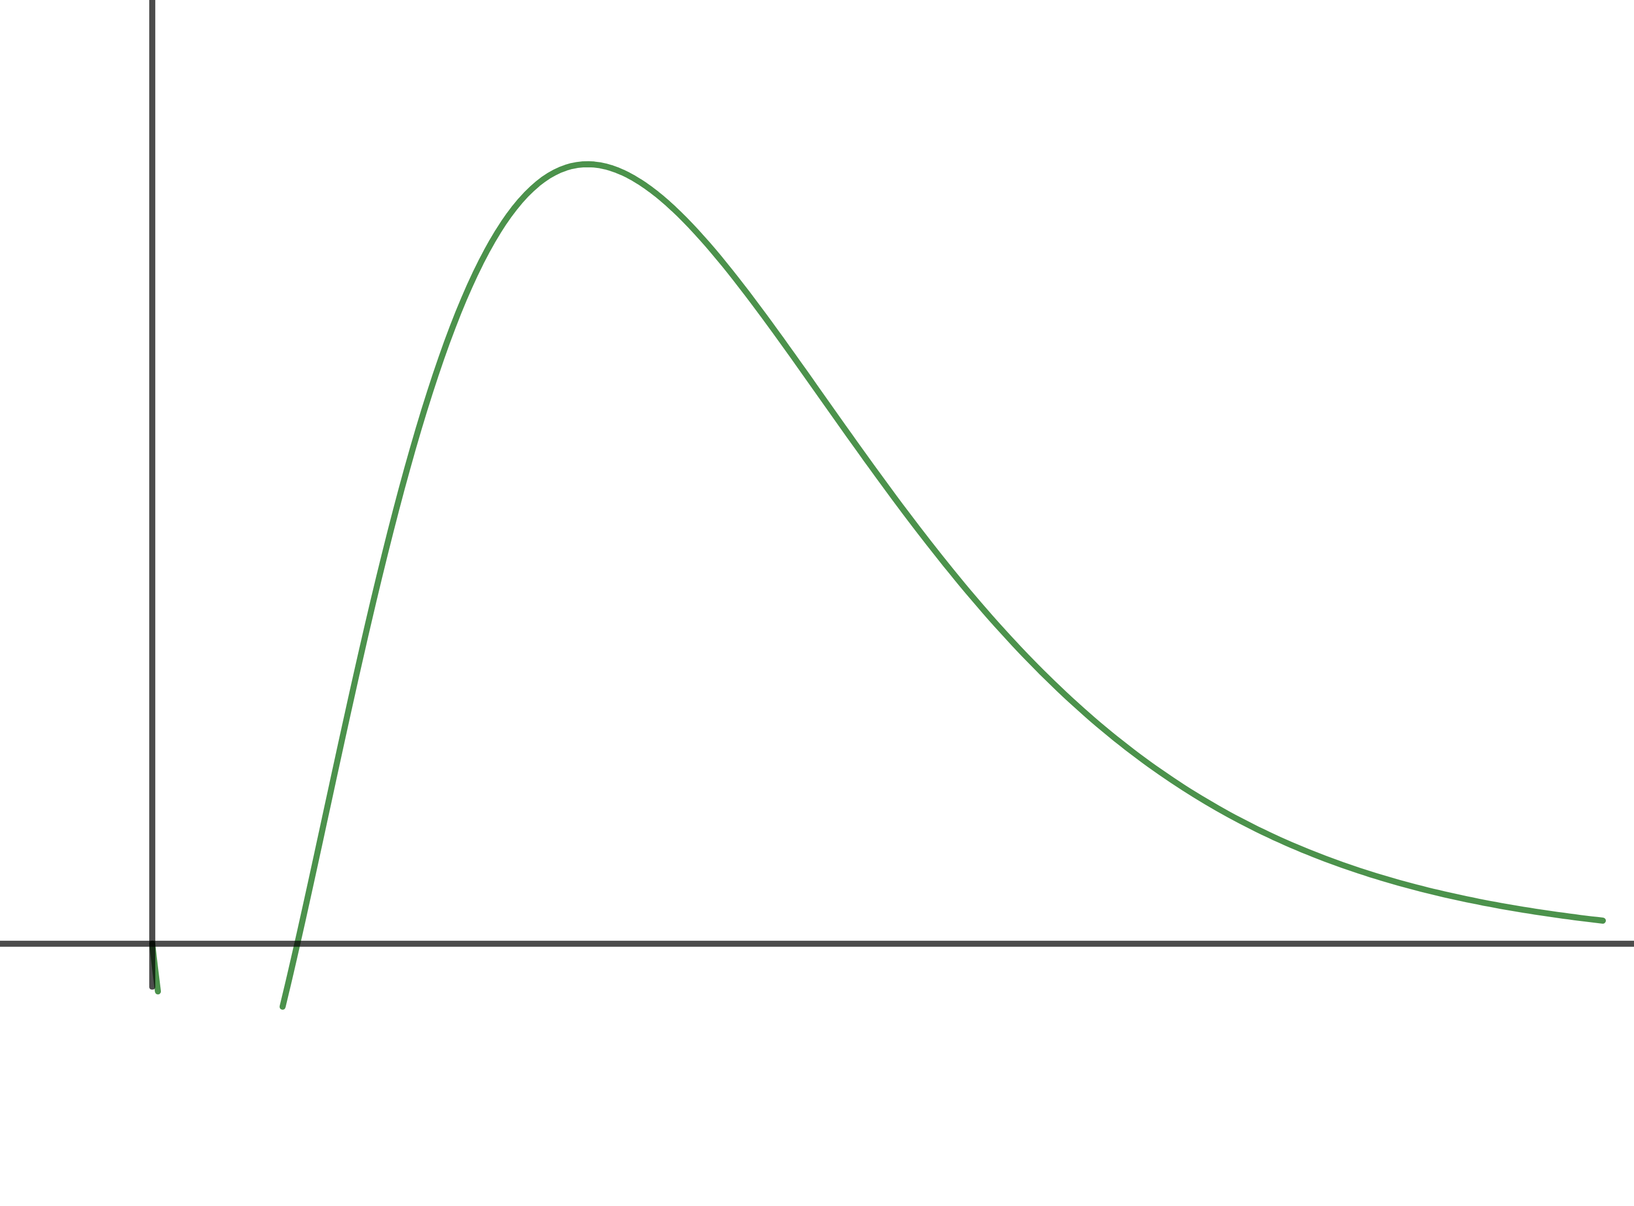
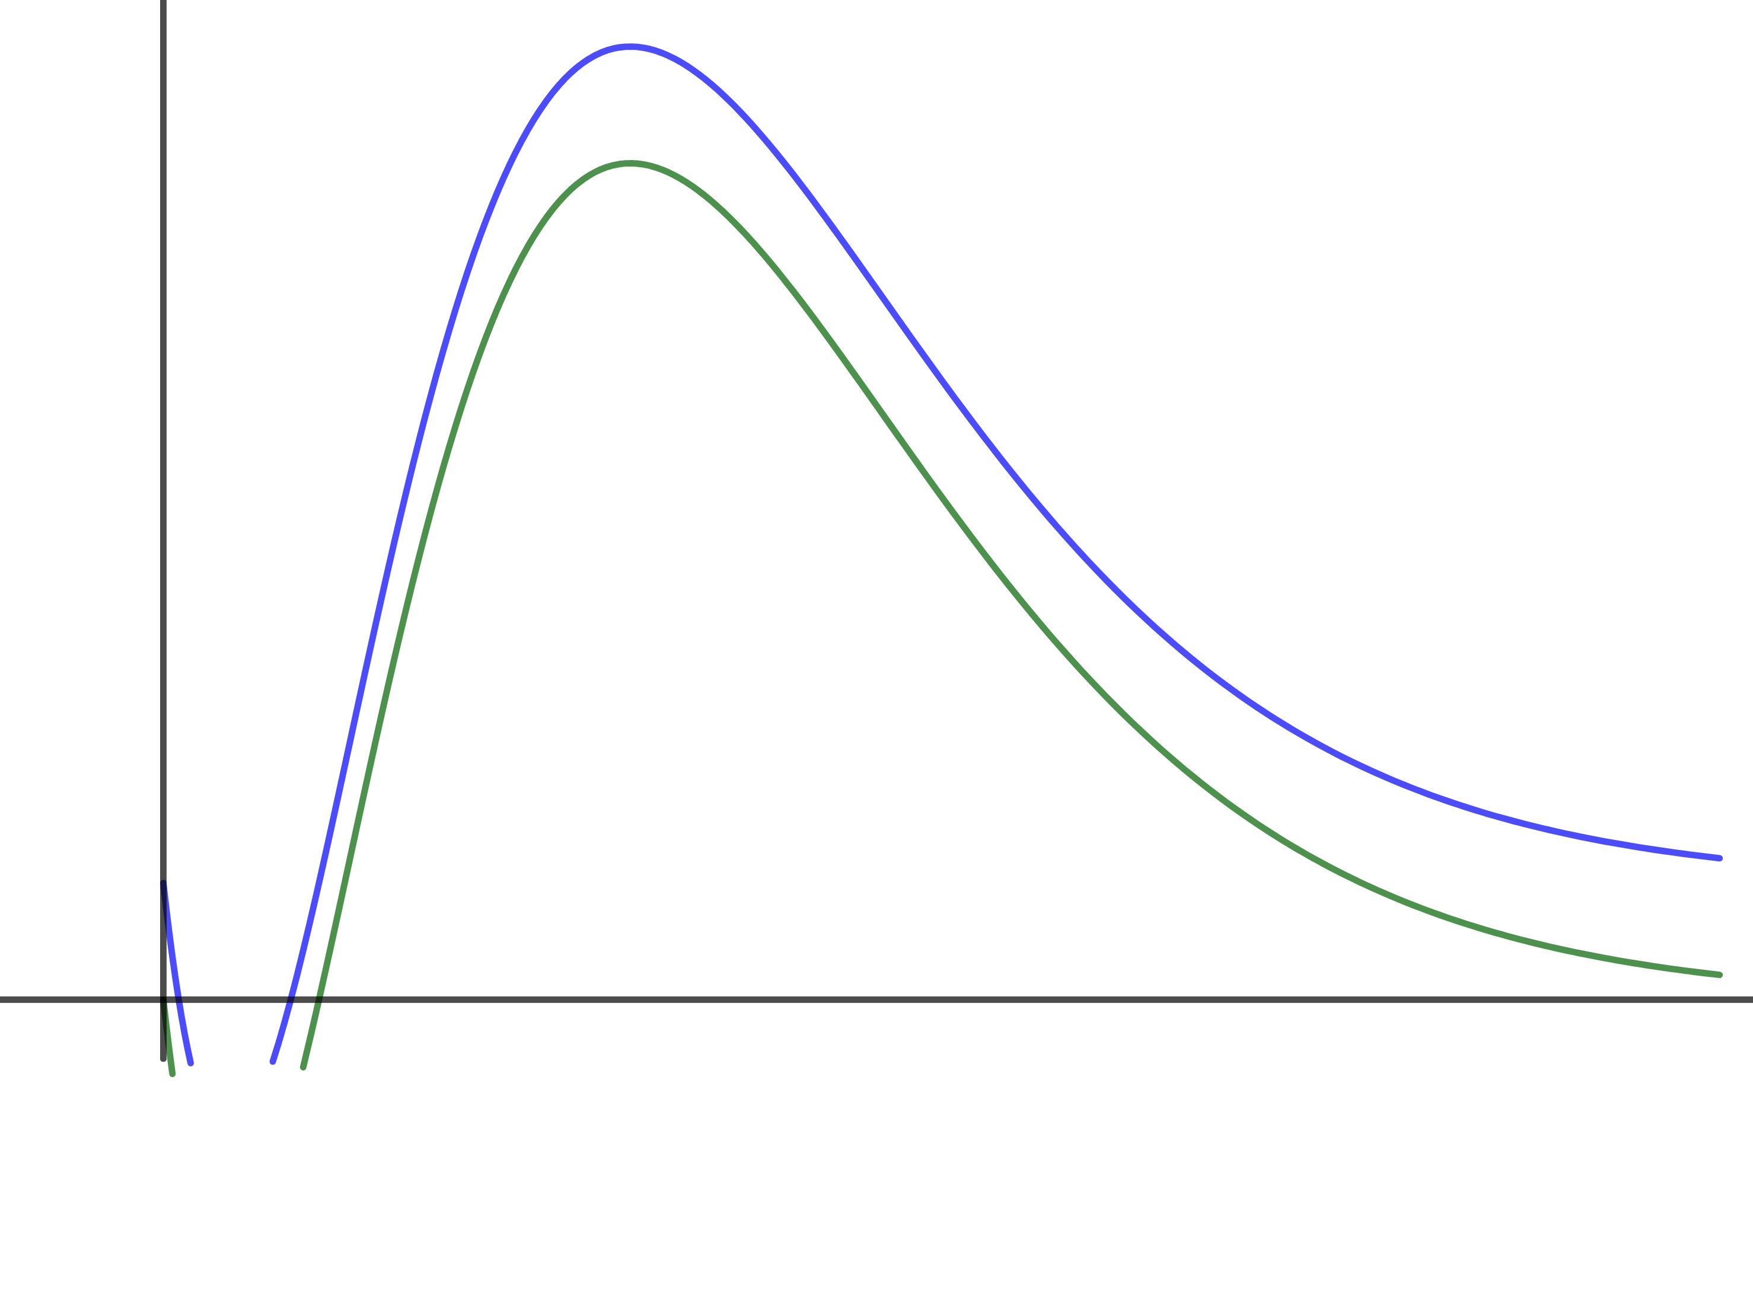

Functions: graph transformations
Since we defined basic elementary functions, their graphs are considerably widely known. In the same time, the graph of an arbitrary elementary function is a comprehensive objects and plotting it remains challenging.
Still in certain cases we may get the graph of non-basic function by subsequently applying simple transformation to it.
Vertical shift
$$y=f\left(x\right)→ y=f\left(x\right)+C$$

Slide 29
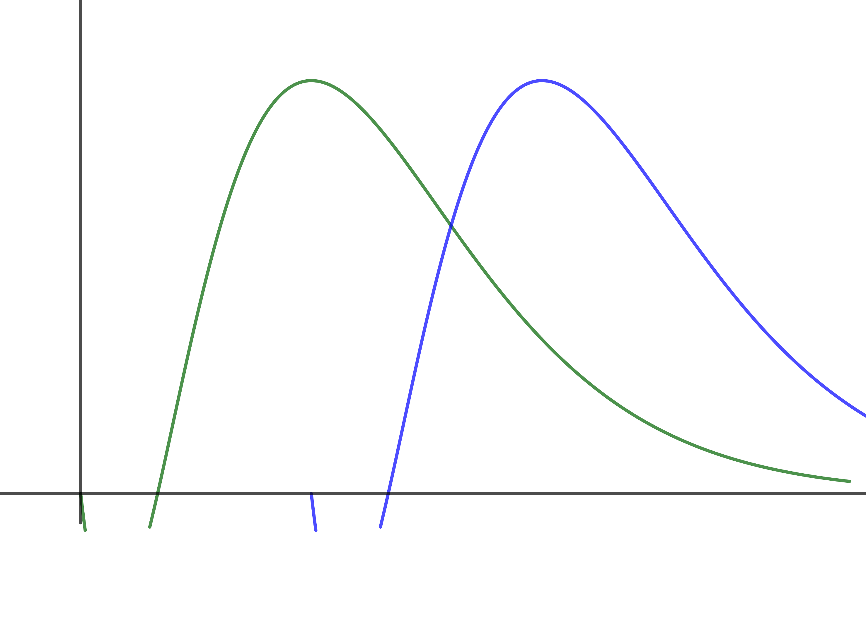

Functions: graph transformations
Since we defined basic elementary functions, their graphs are considerably widely known. In the same time, the graph of an arbitrary elementary function is a comprehensive objects and plotting it remains challenging.
Still in certain cases we may get the graph of non-basic function by subsequently applying simple transformation to it.
Horizontal shift
$$y=f\left(x\right)→ y=f\left(x+C\right)$$

Slide 30
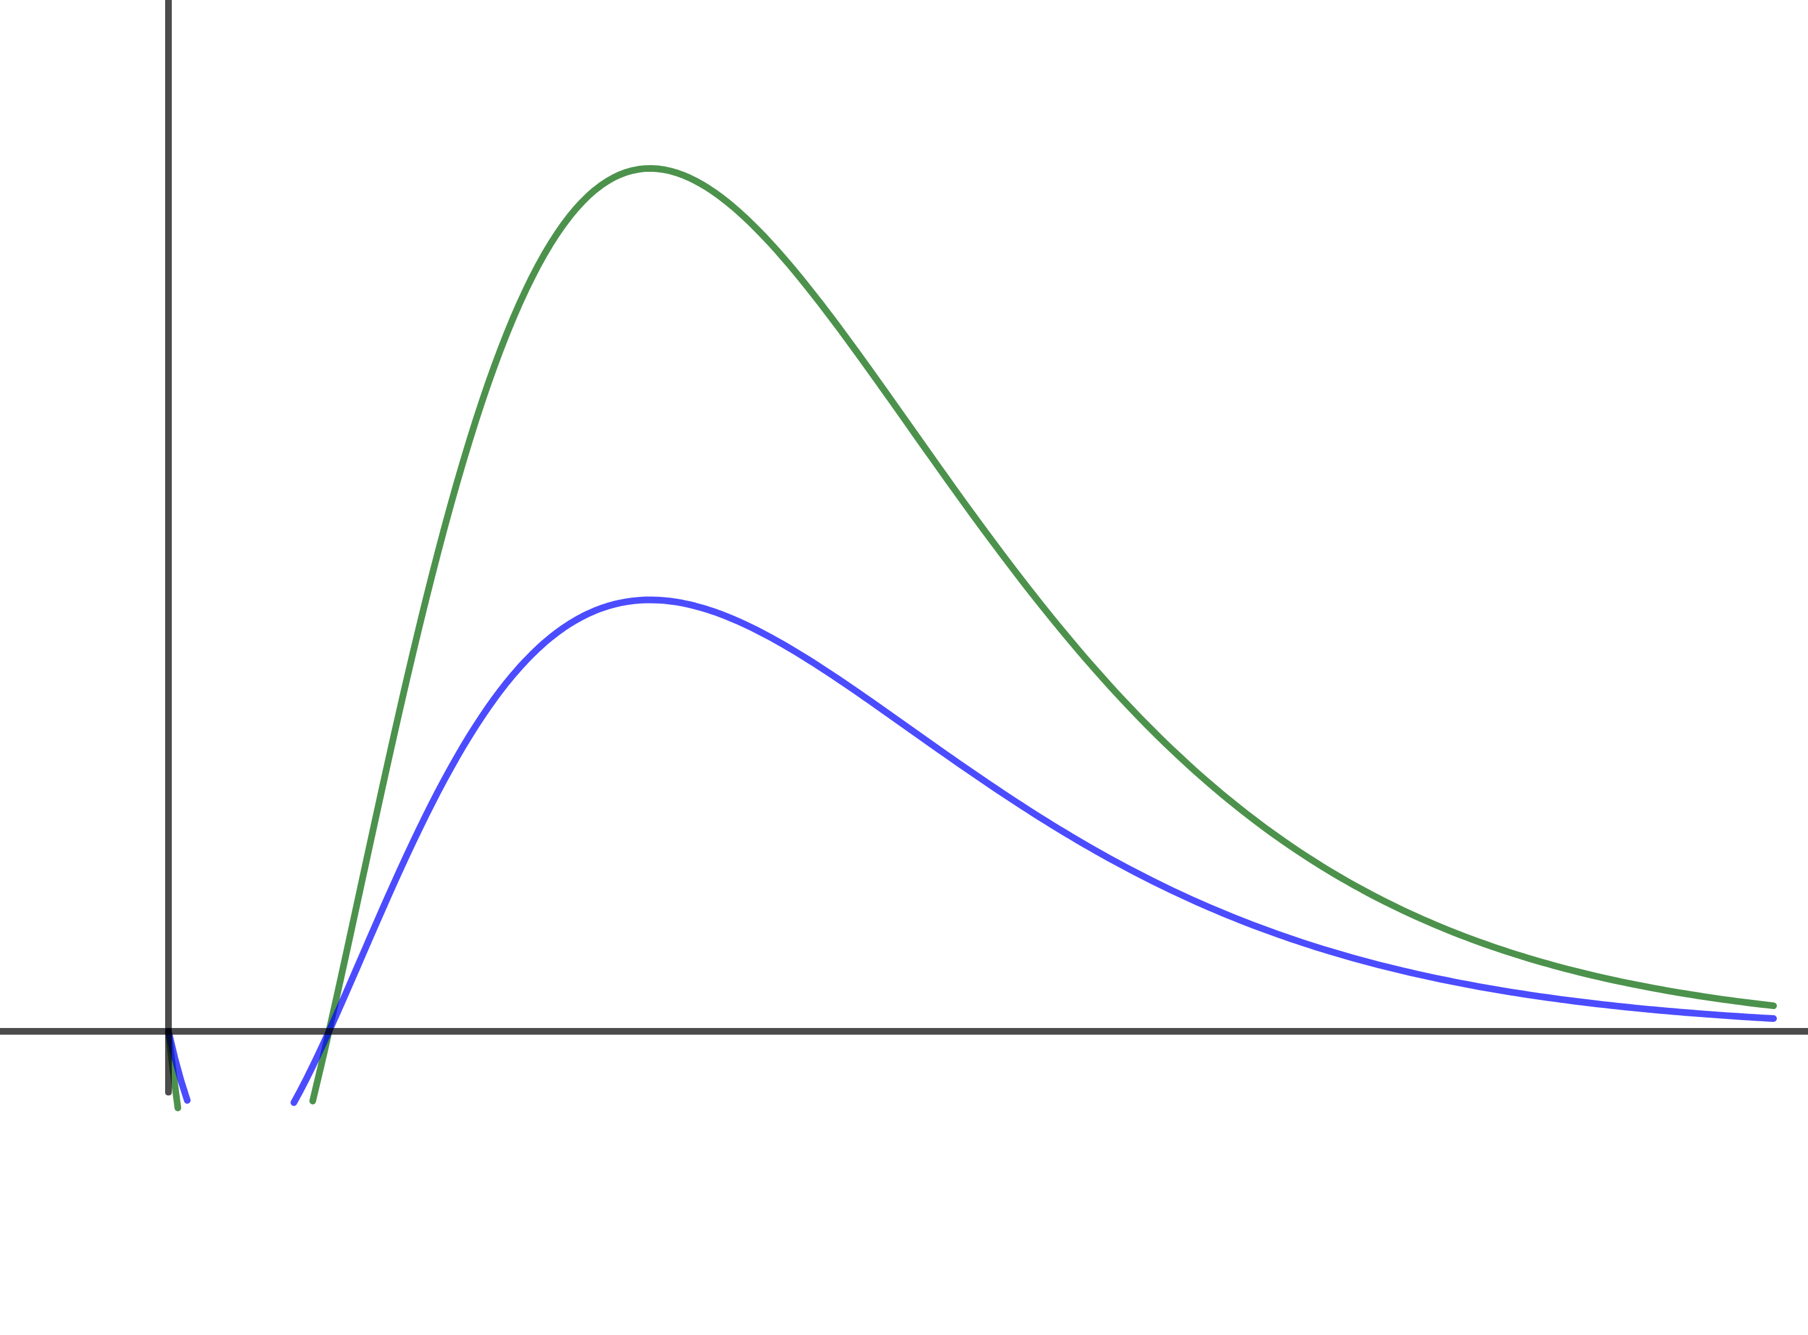

Functions: graph transformations
Since we defined basic elementary functions, their graphs are considerably widely known. In the same time, the graph of an arbitrary elementary function is a comprehensive objects and plotting it remains challenging.
Still in certain cases we may get the graph of non-basic function by subsequently applying simple transformation to it.
Vertical contraction
$$y=f\left(x\right)→ y=C⋅f\left(x\right)$$

Slide 31
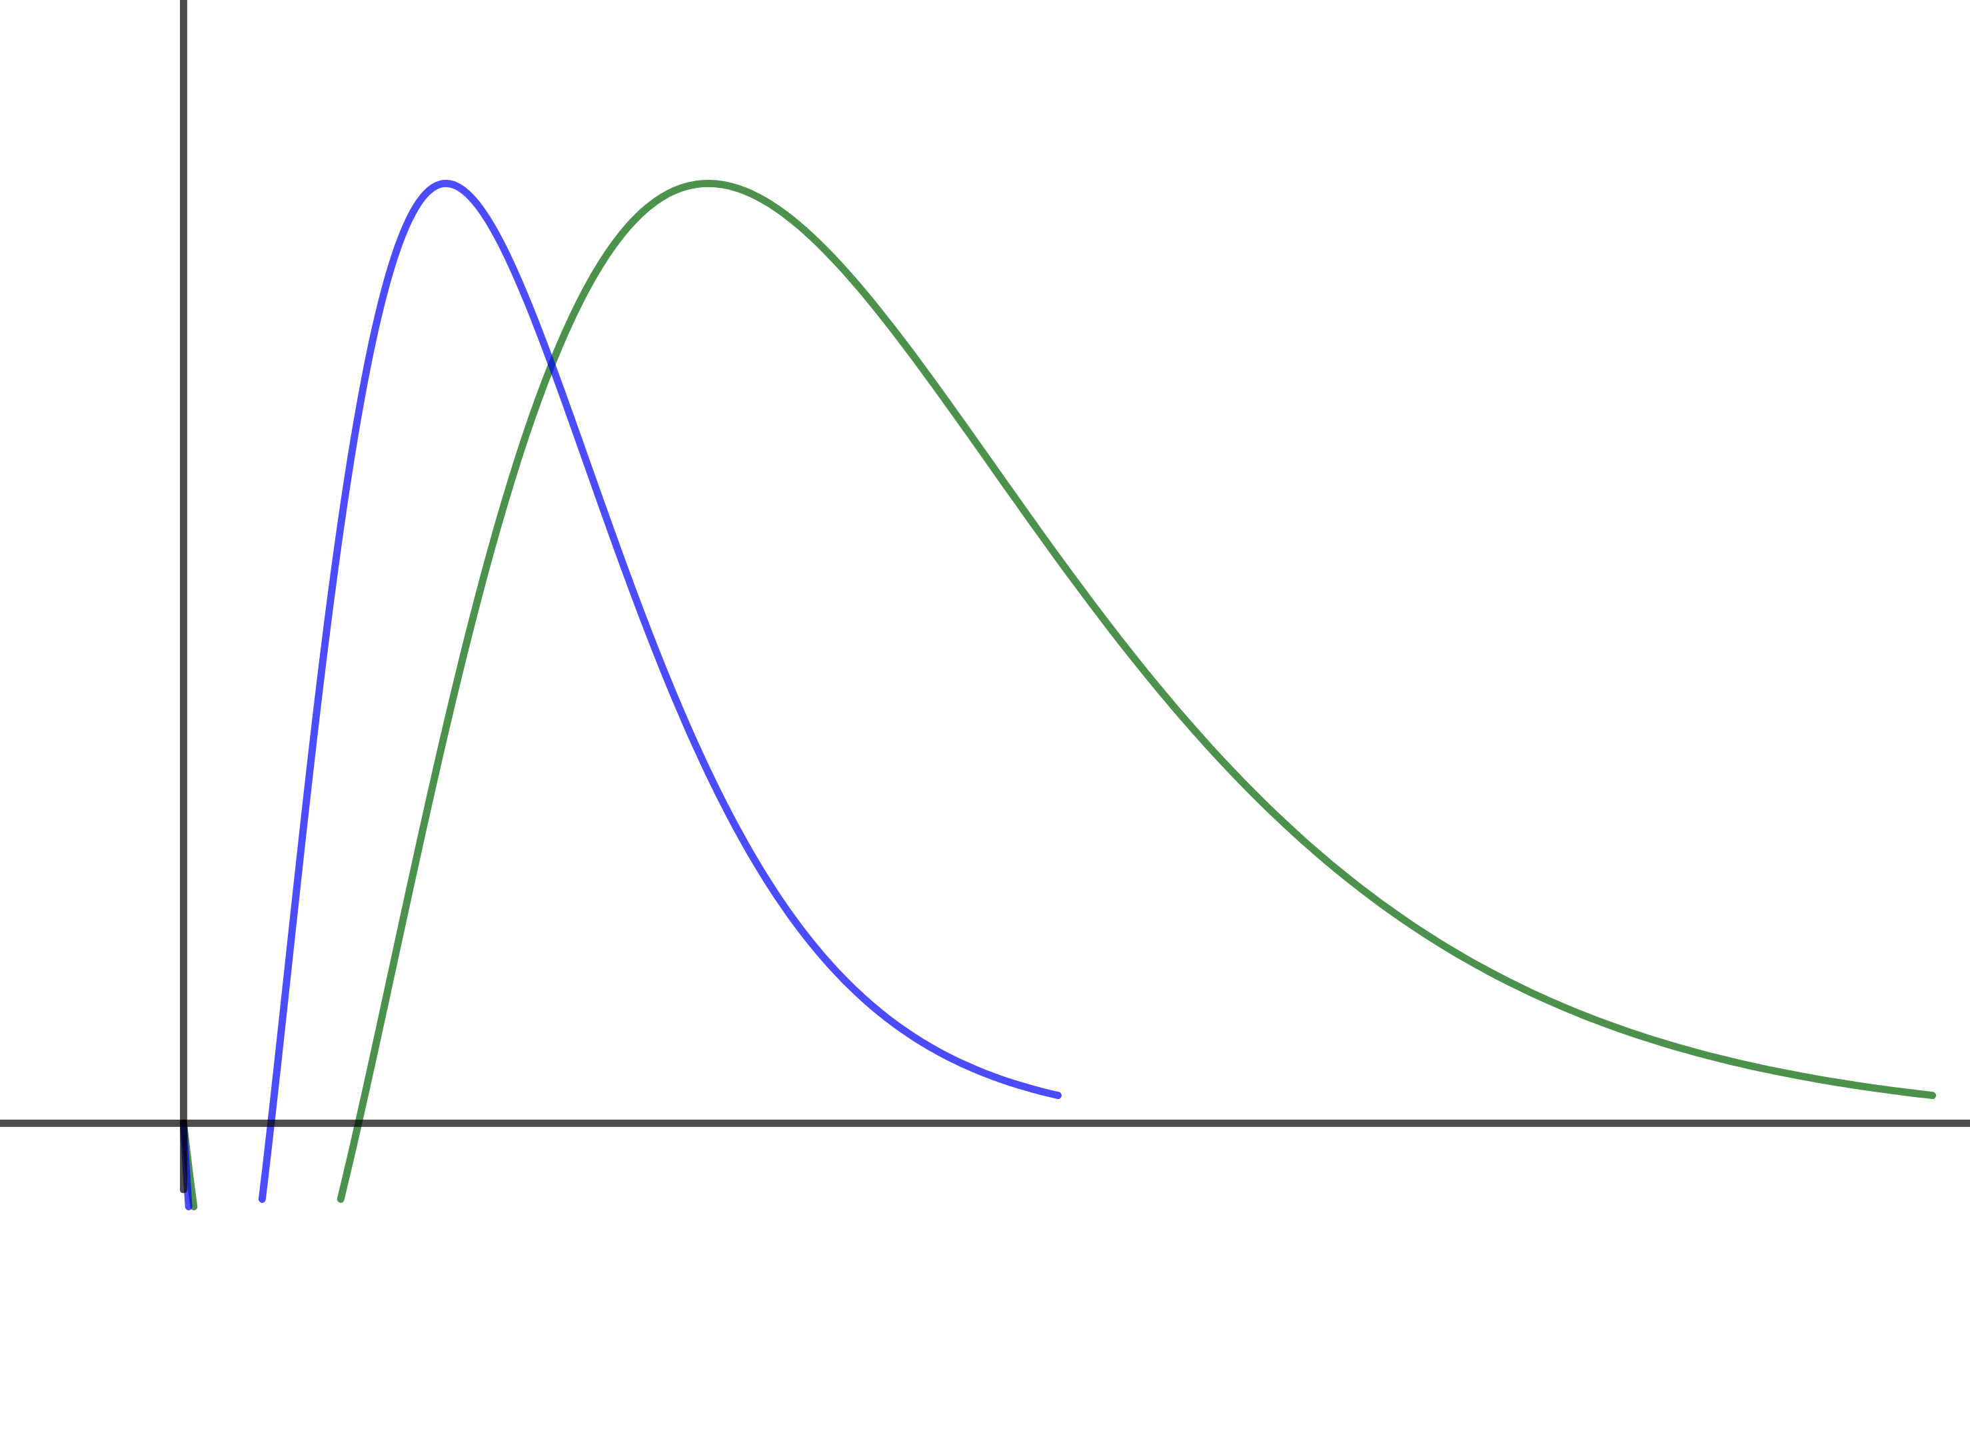

Functions: graph transformations
Since we defined basic elementary functions, their graphs are considerably widely known. In the same time, the graph of an arbitrary elementary function is a comprehensive objects and plotting it remains challenging.
Still in certain cases we may get the graph of non-basic function by subsequently applying simple transformation to it.
Horizontal contraction
$$y=f\left(x\right)→ y=f\left(C⋅x\right)$$

Slide 32
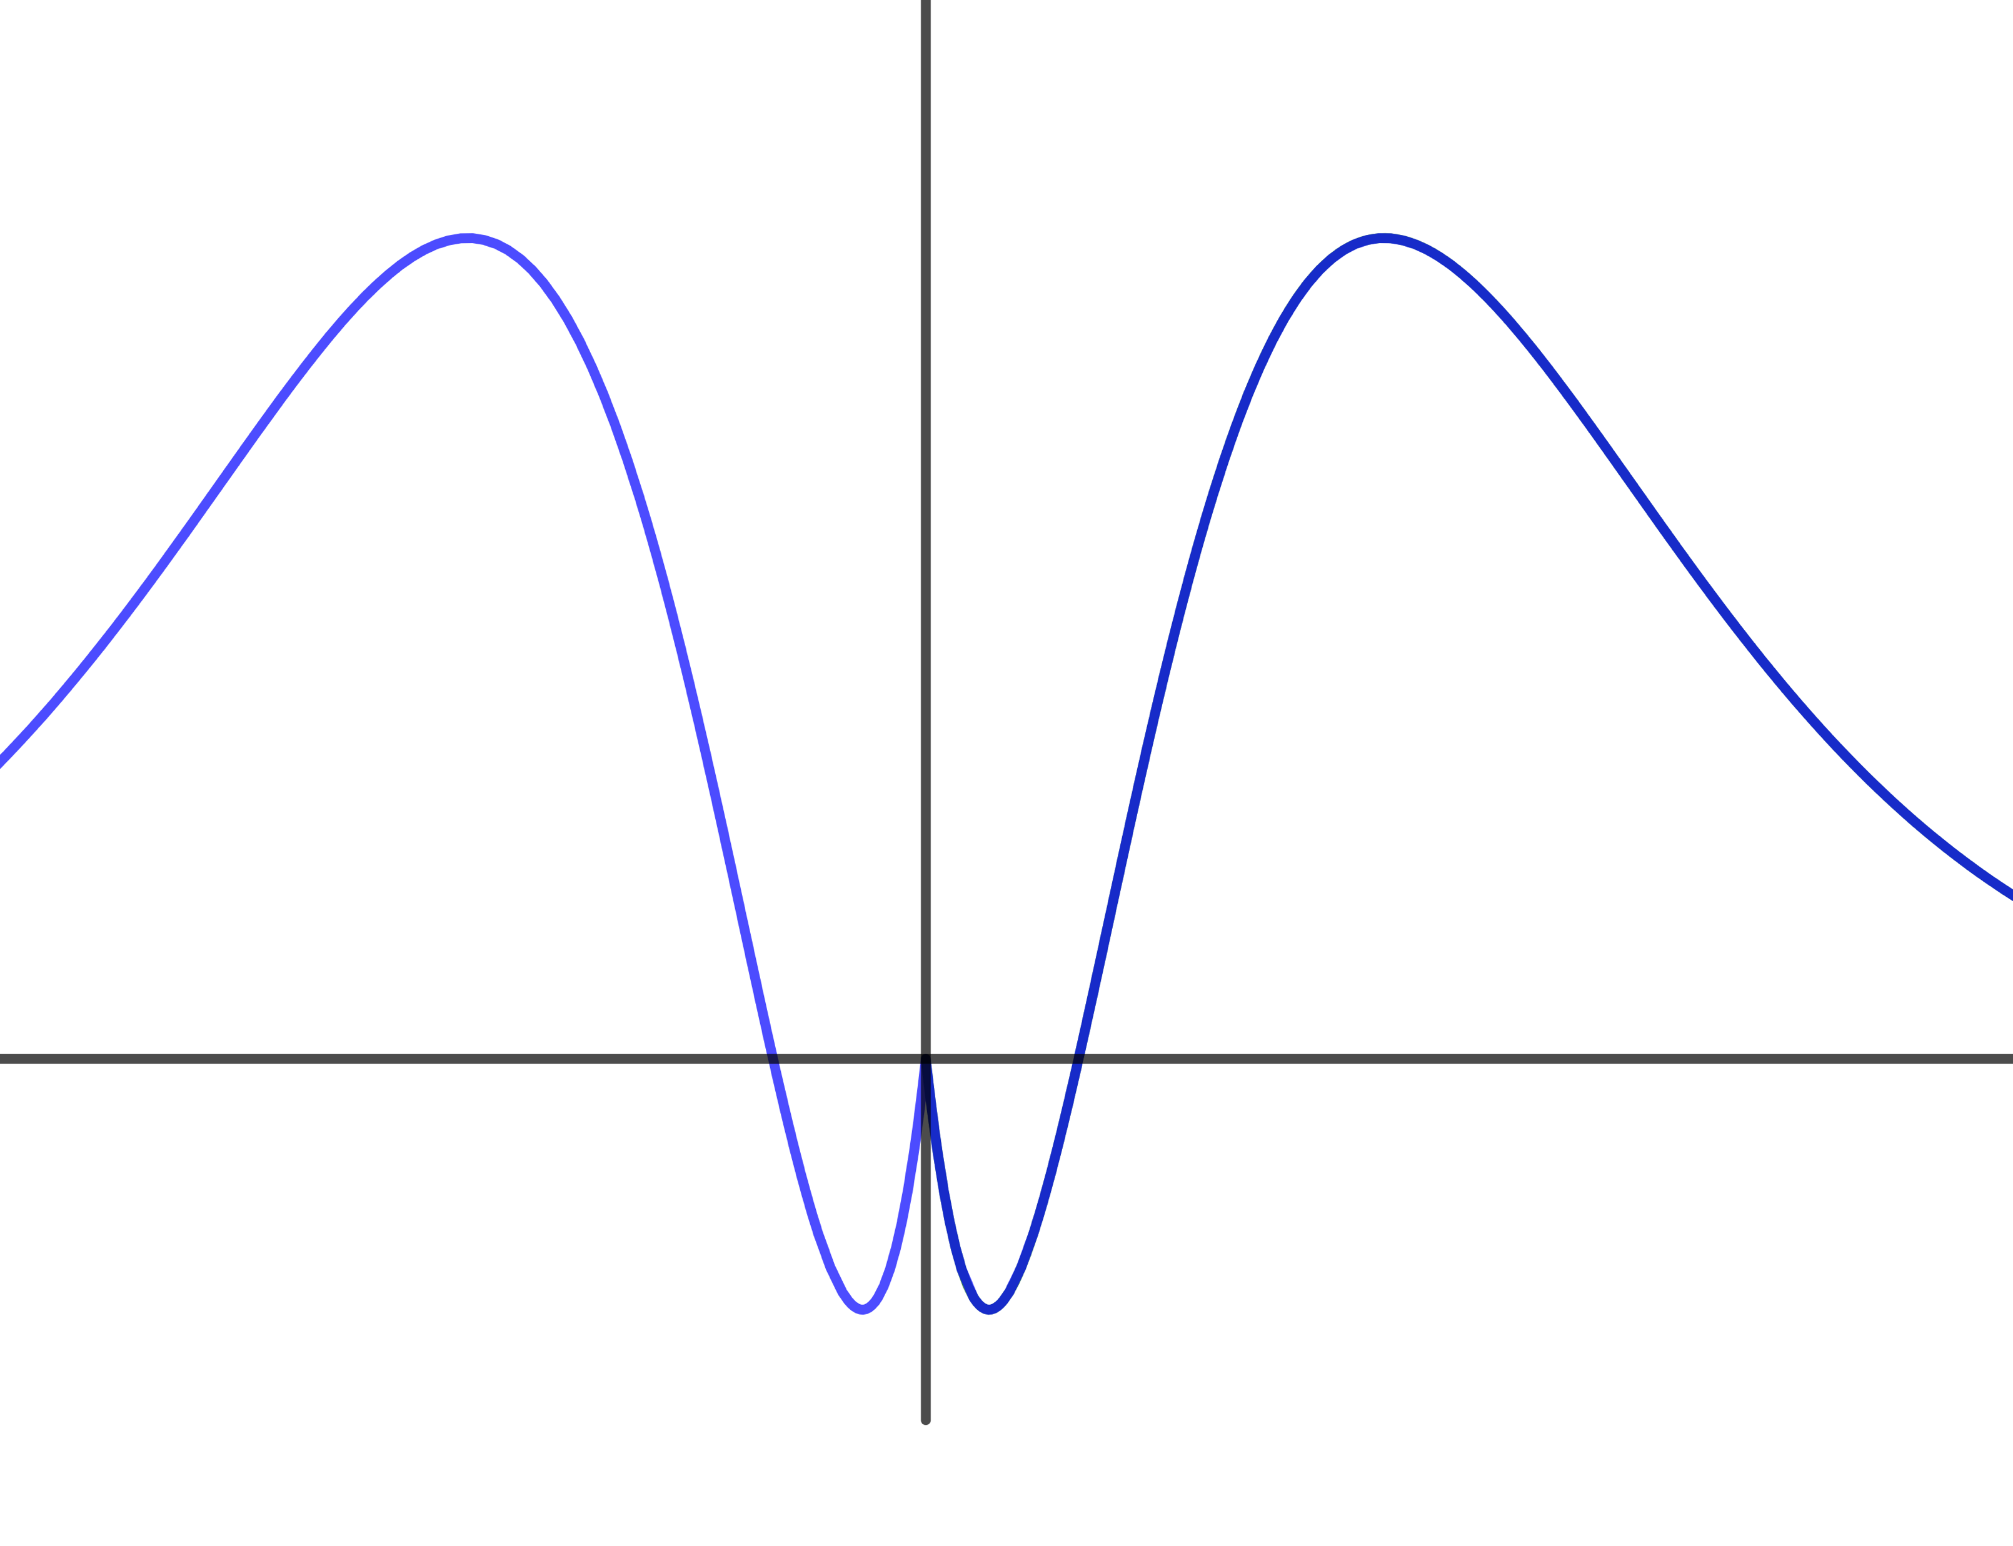

Functions: graph transformations
Since we defined basic elementary functions, their graphs are considerably widely known. In the same time, the graph of an arbitrary elementary function is a comprehensive objects and plotting it remains challenging.
Still in certain cases we may get the graph of non-basic function by subsequently applying simple transformation to it.
Absolute variable
$$y=f\left(x\right)→ y=f\left(|x|\right)$$

Slide 33
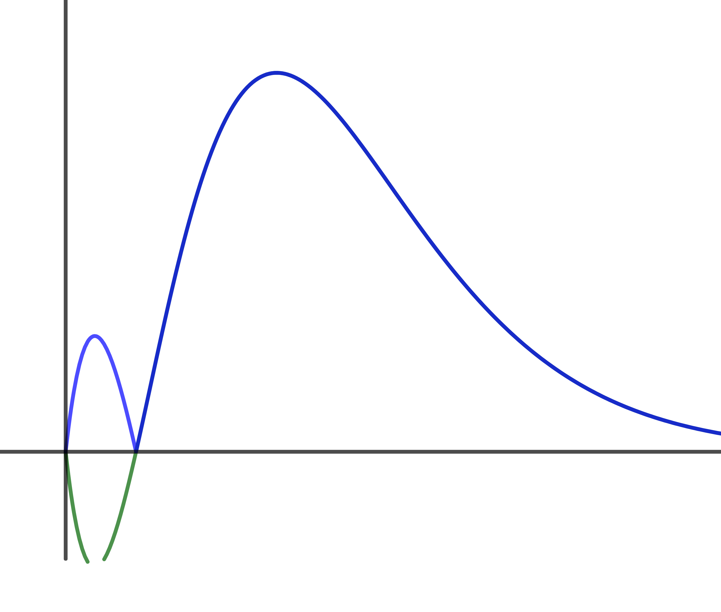

Functions: graph transformations
Since we defined basic elementary functions, their graphs are considerably widely known. In the same time, the graph of an arbitrary elementary function is a comprehensive objects and plotting it remains challenging.
Still in certain cases we may get the graph of non-basic function by subsequently applying simple transformation to it.
Absolute value
$$y=f\left(x\right)→ y=|f\left(x\right)|$$

Slide 34
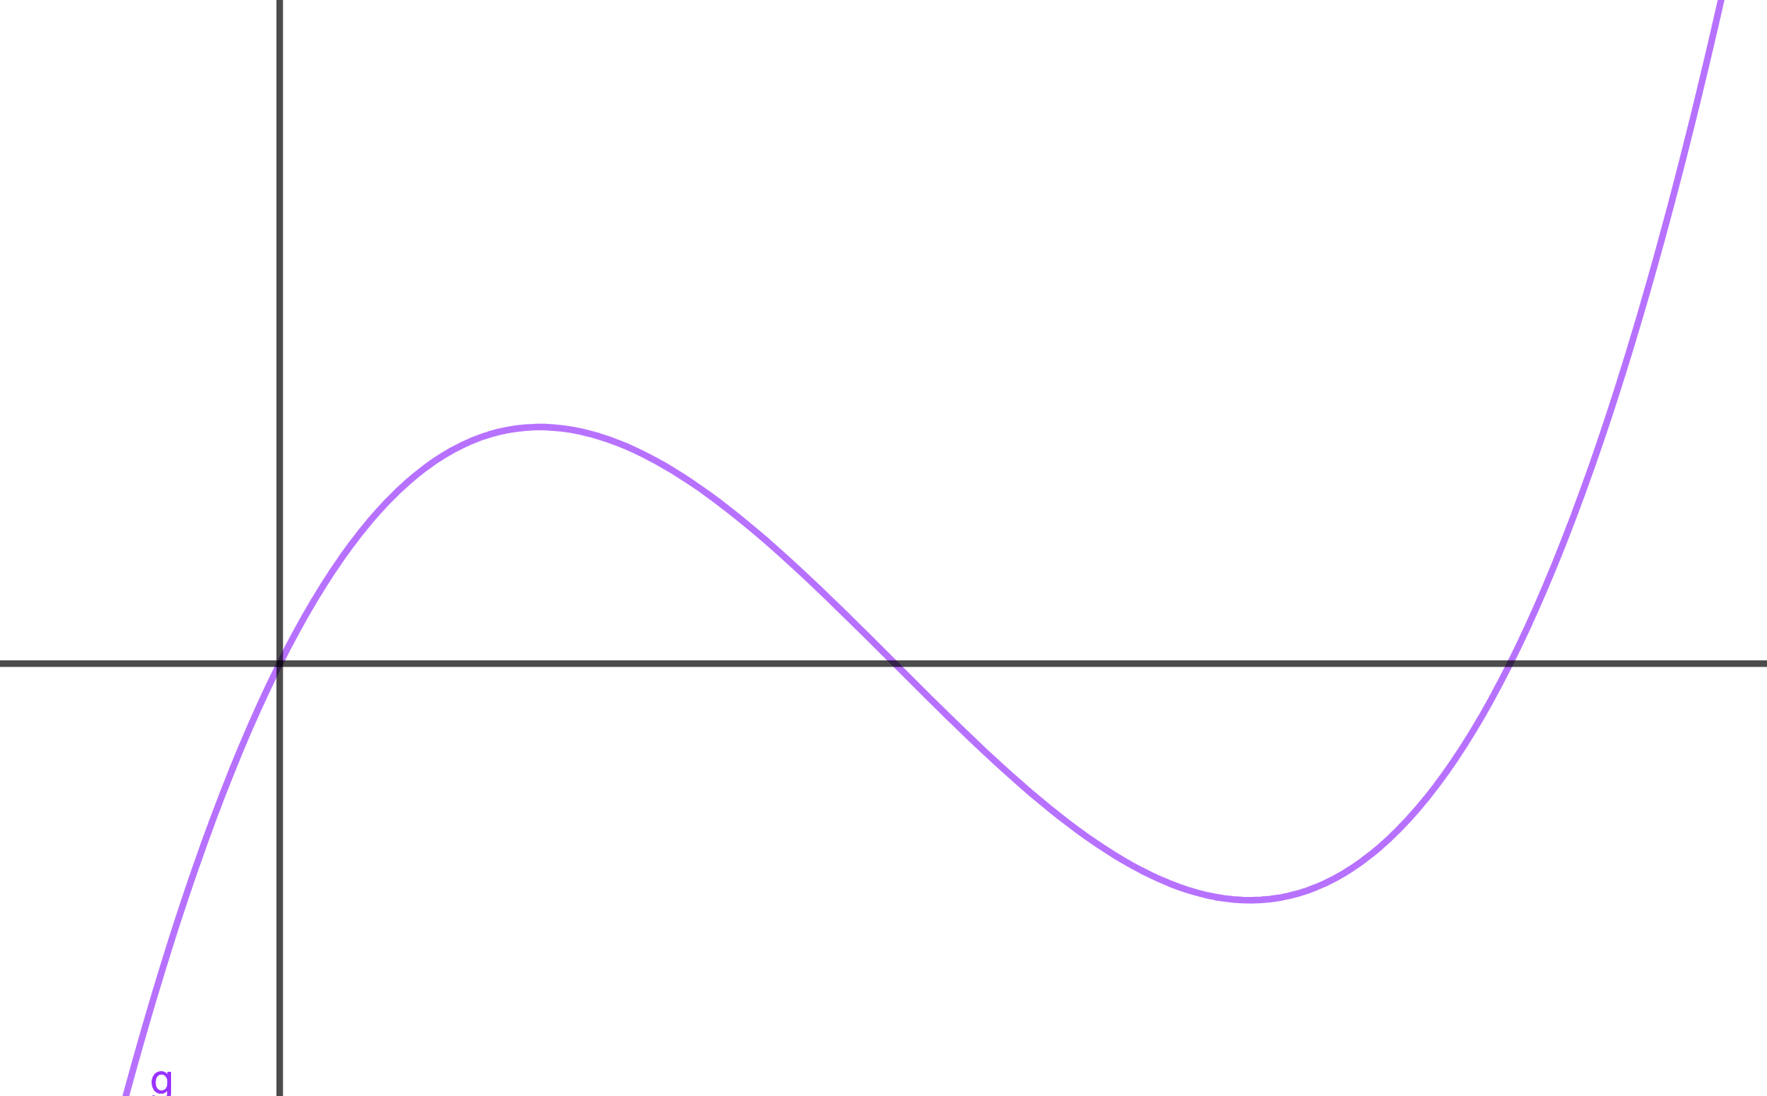
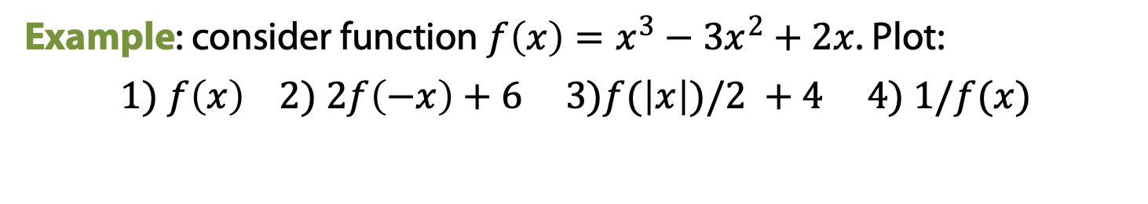
Functions: graph transformations
Example: consider function $f\left(x\right)=x^{3}−3x^{2}+2x$. Plot:
$$1) f\left(x\right) 2) 2f\left(−x\right)+6 3)f(\left|x\right|)/2 +4 4) 1/f(x)$$

Slide 35
Functions: graph transformations
Example: consider function $f\left(x\right)=x^{3}−3x^{2}+2x$. Plot:
$$1) f\left(x\right) 2) 2f\left(−x\right)+6 3)f(\left|x\right|)/2 +4 4) 1/f(x)$$

Slide 36
Functions: graph transformations
Example: consider function $f\left(x\right)=x^{3}−3x^{2}+2x$. Plot:
$$1) f\left(x\right) 2) 2f\left(−x\right)+6 3)f(\left|x\right|)/2 +4 4) 1/f(x)$$

Slide 37
Functions: graph transformations
Example: consider function $f\left(x\right)=x^{3}−3x^{2}+2x$. Plot:
$$1) f\left(x\right) 2) 2f\left(−x\right)+6 3)f(\left|x\right|)/2 +4 4) 1/f(x)$$

Slide 38
Sequences: definition

Slide 39
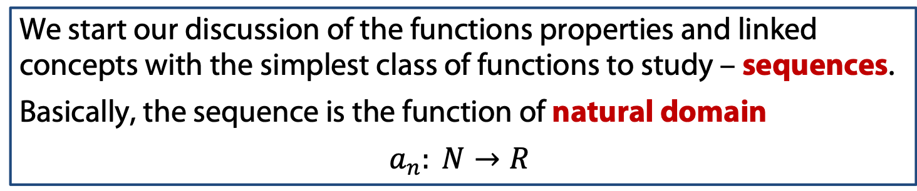
Sequences: definition
We start our discussion of the functions properties and linked concepts with the simplest class of functions to study – sequences.
Basically, the sequence is the function of natural domain
$$a_{n}: N→R$$

Slide 40
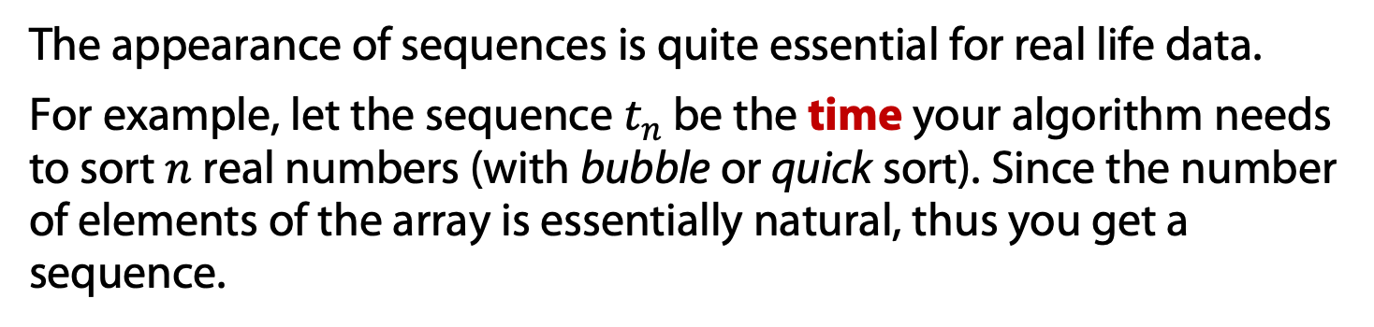
Sequences: definition
We start our discussion of the functions properties and linked concepts with the simplest class of functions to study – sequences.
Basically, the sequence is the function of natural domain
$$a_{n}: N→R$$
The appearance of sequences is quite essential for real life data.
For example, let the sequence $t_{n}$ be the time your algorithm needs to sort $n$ real numbers (with bubble or quick sort). Since the number of elements of the array is essentially natural, thus you get a sequence.

Slide 41
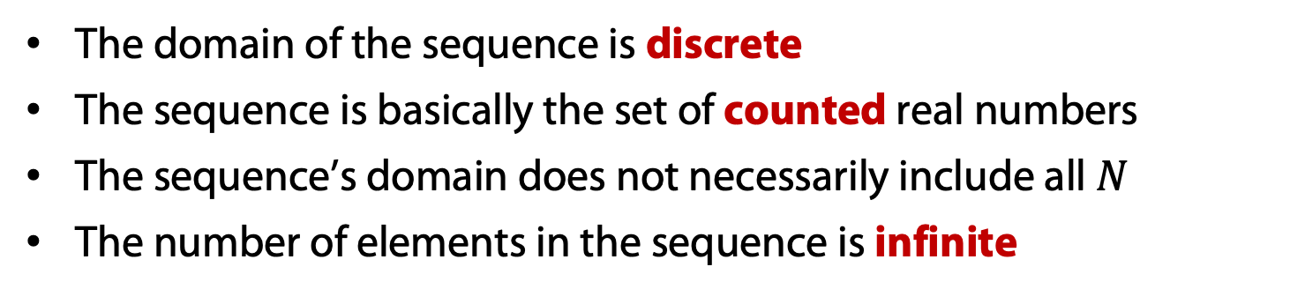
Sequences: definition
We start our discussion of the functions properties and linked concepts with the simplest class of functions to study – sequences.
Basically, the sequence is the function of natural domain
$$a_{n}: N→R$$
The appearance of sequences is quite essential for real life data.
For example, let the sequence $t_{n}$ be the time your algorithm needs to sort $n$ real numbers (with bubble or quick sort). Since the number of elements of the array is essentially natural, thus you get a sequence.
The domain of the sequence is discrete
The sequence is basically the set of counted real numbers
The sequence’s domain does not necessarily include all $N$
The number of elements in the sequence is infinite

Slide 42
Limit of Sequences: definition

Slide 43
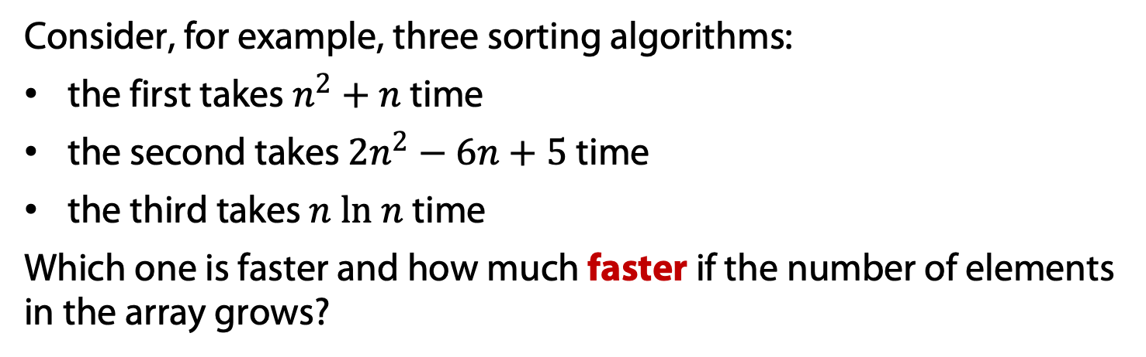
Limits of sequence: the definition
Consider, for example, three sorting algorithms:
the first takes $n^{2}+n$ time
the second takes $2n^{2}−6n+5$time
the third takes $n ln n$ time
Which one is faster and how much faster if the number of elements in the array grows?

Slide 44
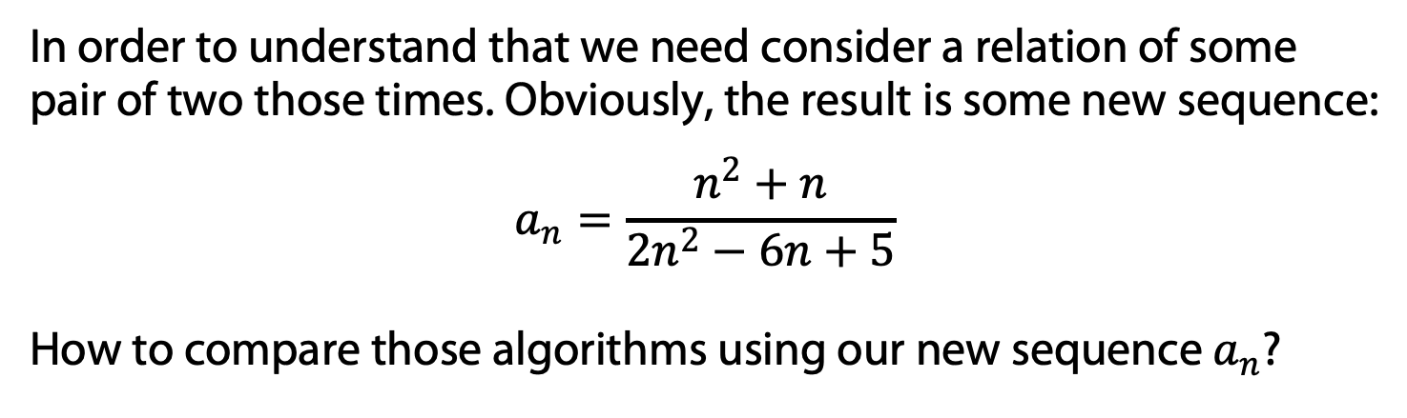
Limits of sequence: the definition
Consider, for example, three sorting algorithms:
the first takes $n^{2}+n$ time
the second takes $2n^{2}−6n+5$time
the third takes $n ln n$ time
Which one is faster and how much faster if the number of elements in the array grows?
In order to understand that we need consider a relation of some pair of two those times. Obviously, the result is some new sequence:
$$a_{n}=\frac{n^{2}+n}{2n^{2}−6n+5}$$
How to compare those algorithms using our new sequence $a_{n}$?

Slide 45
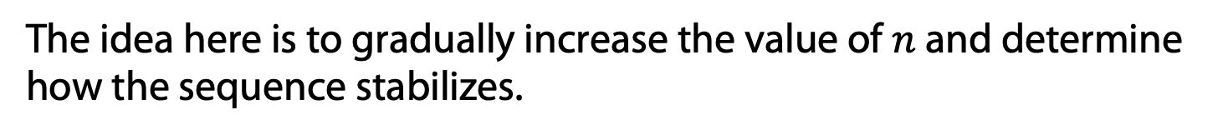
Limits of sequence: the definition
The idea here is to gradually increase the value of $n$ and determine how the sequence stabilizes.

Slide 46
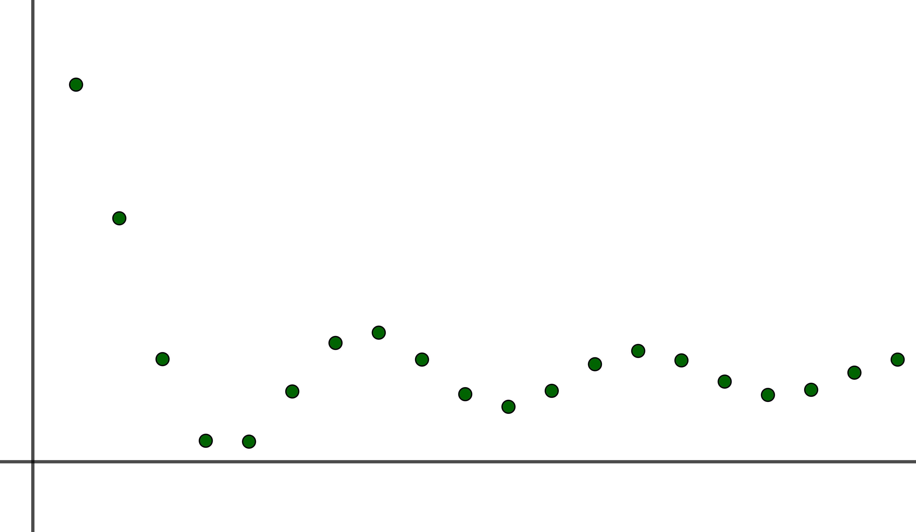

Limits of sequence: the definition
The idea here is to gradually increase the value of $n$ and determine how the sequence stabilizes.
Here we have come up with the idea of the limit of the sequence – the real number that resembles our sequence the most as the element’s number infinitely grows (approaches infinity).
$$a_{n}=2+\frac{\sin{n}}{n}$$

Slide 47

Limits of sequence: the definition
The idea here is to gradually increase the value of $n$ and determine how the sequence stabilizes.
Here we have come up with the idea of the limit of the sequence – the real number that resembles our sequence the most as the element’s number infinitely grows (approaches infinity).
The notation:
$$\lim_{n→∞}{a_{n}}=C$$
$$a_{n}=2+\frac{\sin{n}}{n}$$

Slide 48
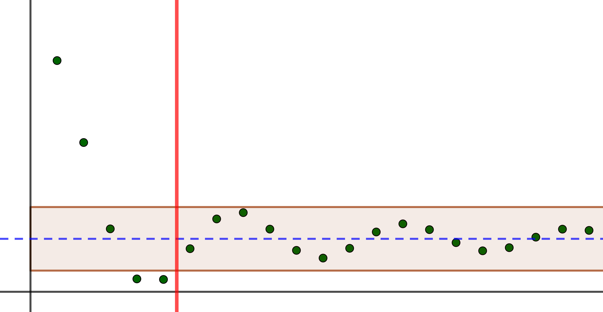
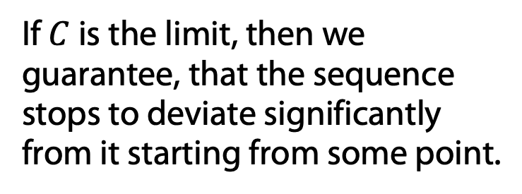
Limits of sequence: the definition
The idea here is to gradually increase the value of $n$ and determine how the sequence stabilizes.
Here we have come up with the idea of the limit of the sequence – the real number that resembles our sequence the most as the element’s number infinitely grows (approaches infinity).
The notation:
$$\lim_{n→∞}{a_{n}}=C$$
If $C$ is the limit, then we guarantee, that the sequence stops to deviate significantly from it starting from some point.
$$a_{n}=2+\frac{\sin{n}}{n}$$

Slide 49
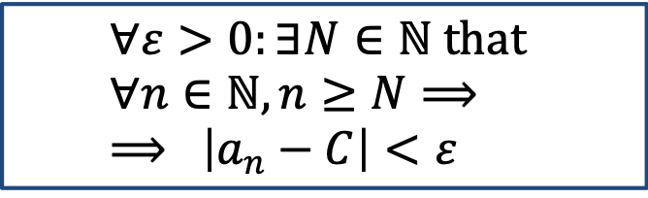
Limits of sequence: the definition
The idea here is to gradually increase the value of $n$ and determine how the sequence stabilizes.
Here we have come up with the idea of the limit of the sequence – the real number that resembles our sequence the most as the element’s number infinitely grows (approaches infinity).
The notation:
$$\lim_{n→∞}{a_{n}}=C$$
$$∀ε>0:∃N∈ℕ that \\ ∀n∈ℕ, n≥N⟹ \\ ⟹ \left|a_{n}−C\right|<ε$$
$$a_{n}=2+\frac{\sin{n}}{n}$$

Slide 50
Limit of Sequences: examples

Slide 51

Limits of sequence: examples
Example: $$a_{n}=\frac{1}{n}$$

Slide 52
Limits of sequence: examples
Example: $$a_{n}=\frac{1}{n}$$
This sequence has the limit equal to $0$, it is called infinitesimal.

Slide 53

Limits of sequence: examples
Example: $$a_{n}=\frac{1}{n}$$
This sequence has the limit equal to $0$, it is called infinitesimal.
Example: $$a_{n}=\frac{\sin{n}}{n}$$

Slide 54
Limits of sequence: examples
Example: $$a_{n}=\frac{1}{n}$$
This sequence has the limit equal to $0$, it is called infinitesimal.
Example: $$a_{n}=\frac{\sin{n}}{n}$$
The product of bounded and infinitesimal is infinitesimal.

Slide 55

Limits of sequence: examples
Example: $$a_{n}=\frac{1}{n}$$
This sequence has the limit equal to $0$, it is called infinitesimal.
Example: $$a_{n}=2n+1$$

Slide 56

Limits of sequence: examples
Example: $$a_{n}=\frac{1}{n}$$
This sequence has the limit equal to $0$, it is called infinitesimal.
Example: $$a_{n}=2n+1$$
This sequence is unbounded and approaches $+∞$. This is not the same!

Slide 57

Limits of sequence: examples
Example: $$a_{n}=\frac{1}{n}$$
This sequence has the limit equal to $0$, it is called infinitesimal.
Example: $$a_{n}=2n+1$$
This sequence is unbounded and approaches $+∞$. This is not the same!
Example: $$a_{n}=\sin{πn}$$

Slide 58
Limits of sequence: examples
Example: $$a_{n}=\frac{1}{n}$$
This sequence has the limit equal to $0$, it is called infinitesimal.
Example: $$a_{n}=2n+1$$
This sequence is unbounded and approaches $+∞$. This is not the same!
Example: $$a_{n}=\sin{πn}$$
This sequence is has no limit or it does not converge.

Slide 59
Limit of Sequences: arithmetic rules

Slide 60
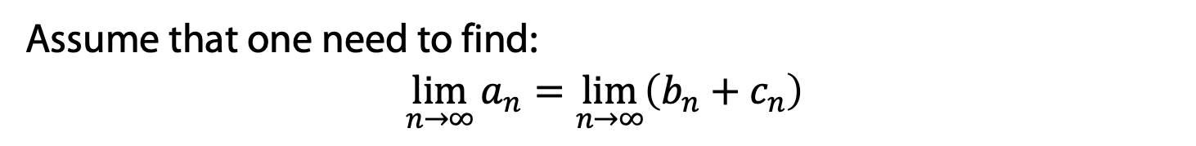
Limits of sequence: arithmetic rules
To avoid calculation by the definition every time, one could use arithmetic rules for limits.
Assume that one need to find:
$$\lim_{n→∞}{a_{n}}=\lim_{n→∞}\left(b_{n}+c_{n}\right)$$

Slide 61
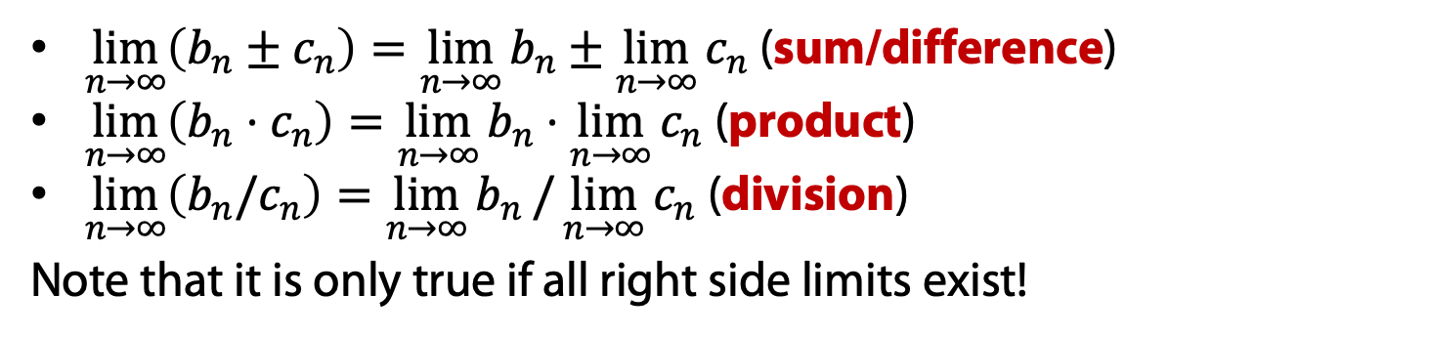
Limits of sequence: arithmetic rules
To avoid calculation by the definition every time, one could use arithmetic rules for limits.
Assume that one need to find:
$$\lim_{n→∞}{a_{n}}=\lim_{n→∞}\left(b_{n}+c_{n}\right)$$
$\lim_{n→∞}\left(b_{n}±c_{n}\right)=\lim_{n→∞}{b_{n}}±\lim_{n→∞}{c_{n}}$ (sum/difference)
$\lim_{n→∞}\left(b_{n}⋅c_{n}\right)=\lim_{n→∞}{b_{n}}⋅\lim_{n→∞}{c_{n}}$ (product)
$\lim_{n→∞}\left(b_{n}/c_{n}\right)=\lim_{n→∞}{b_{n}}/\lim_{n→∞}{c_{n}}$ (division)
Note that it is only true if all right side limits exist!

Slide 62

Limits of sequence: arithmetic rules
To avoid calculation by the definition every time, one could use arithmetic rules for limits.
Assume that one need to find:
$$\lim_{n→∞}{a_{n}}=\lim_{n→∞}\left(b_{n}+c_{n}\right)$$
$\lim_{n→∞}\left(b_{n}±c_{n}\right)=\lim_{n→∞}{b_{n}}±\lim_{n→∞}{c_{n}}$ (sum/difference)
$\lim_{n→∞}\left(b_{n}⋅c_{n}\right)=\lim_{n→∞}{b_{n}}⋅\lim_{n→∞}{c_{n}}$ (product)
$\lim_{n→∞}\left(b_{n}/c_{n}\right)=\lim_{n→∞}{b_{n}}/\lim_{n→∞}{c_{n}}$ (division)
Note that it is only true if all right side limits exist!
Example:
$$a_{n}=\frac{n^{2}+n}{2n^{2}−6n+5}$$

Slide 63

Limits of sequence: arithmetic rules
To avoid calculation by the definition every time, one could use arithmetic rules for limits.
Assume that one need to find:
$$\lim_{n→∞}{a_{n}}=\lim_{n→∞}\left(b_{n}+c_{n}\right)$$
$\lim_{n→∞}\left(b_{n}±c_{n}\right)=\lim_{n→∞}{b_{n}}±\lim_{n→∞}{c_{n}}$ (sum/difference)
$\lim_{n→∞}\left(b_{n}⋅c_{n}\right)=\lim_{n→∞}{b_{n}}⋅\lim_{n→∞}{c_{n}}$ (product)
$\lim_{n→∞}\left(b_{n}/c_{n}\right)=\lim_{n→∞}{b_{n}}/\lim_{n→∞}{c_{n}}$ (division)
Note that it is only true if all right side limits exist!
Example:
$$a_{n}=\frac{{5⋅4}^{\frac{1}{n}}+2^{\frac{1}{n}}−6}{4^{\frac{1}{n}}−6⋅2^{\frac{1}{n}}+5}$$

Slide 64
Limit of Sequences: series

Slide 65
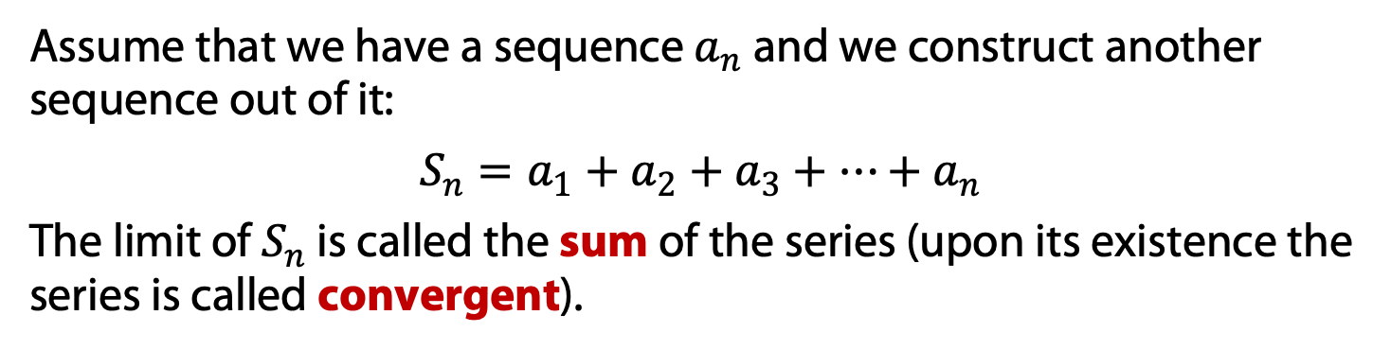
Limits of sequence: series
Another famous example of sequences and its limits are series.
Assume that we have a sequence $a_{n}$ and we construct another sequence out of it:
$$S_{n}=a_{1}+a_{2}+a_{3}+…+a_{n}$$
The limit of $S_{n}$ is called the sum of the series (upon its existence the series is called convergent).

Slide 66
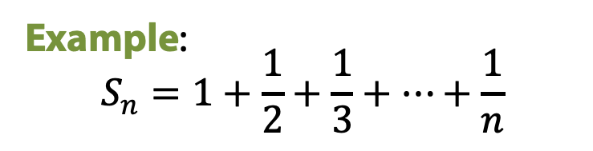
Limits of sequence: series
Another famous example of sequences and its limits are series.
Assume that we have a sequence $a_{n}$ and we construct another sequence out of it:
$$S_{n}=a_{1}+a_{2}+a_{3}+…+a_{n}$$
The limit of $S_{n}$ is called the sum of the series (upon its existence the series is called convergent).
Example:
$$S_{n}=1+\frac{1}{2}+\frac{1}{3}+…+\frac{1}{n}$$

Slide 67
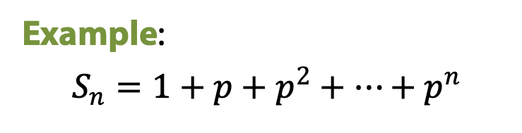
Limits of sequence: series
Another famous example of sequences and its limits are series.
Assume that we have a sequence $a_{n}$ and we construct another sequence out of it:
$$S_{n}=a_{1}+a_{2}+a_{3}+…+a_{n}$$
The limit of $S_{n}$ is called the sum of the series (upon its existence the series is called convergent).
Example:
$$S_{n}=1+p+p^{2}+…+p^{n}$$

Slide 68

Limits of sequence: series
Another famous example of sequences and its limits are series.
Assume that we have a sequence $a_{n}$ and we construct another sequence out of it:
$$S_{n}=a_{1}+a_{2}+a_{3}+…+a_{n}$$
The limit of $S_{n}$ is called the sum of the series (upon its existence the series is called convergent).
Example:
$$S_{n}=p+2p^{2}+…+np^{n}$$

Slide 69
Limit of Sequences: definition of e

Slide 70
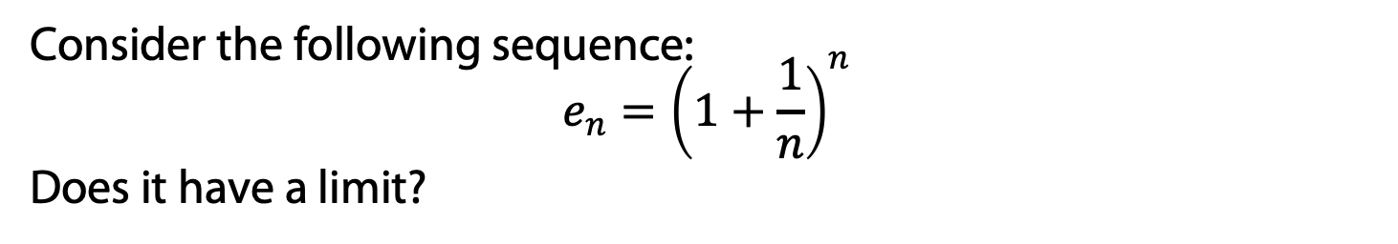
Limits of sequence: definition of e
Consider the following sequence:
$$e_{n}={\left(1+\frac{1}{n}\right)}^{n}$$
Does it have a limit?

Slide 71
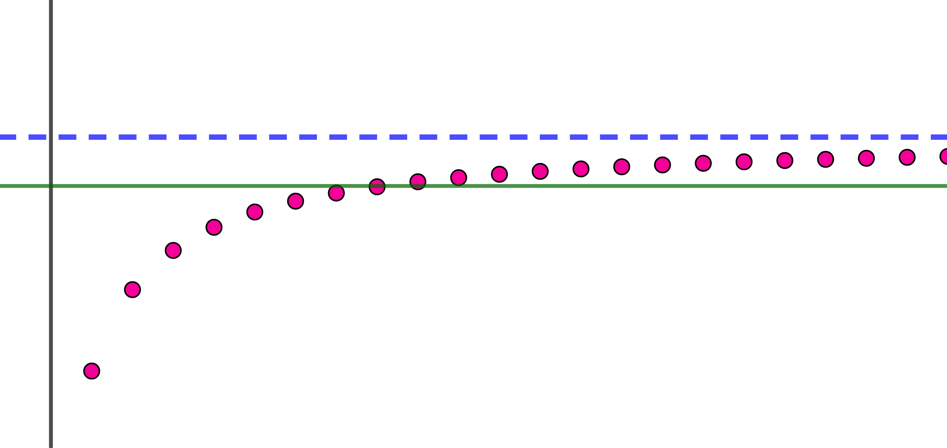
Limits of sequence: definition of e
Consider the following sequence:
$$e_{n}={\left(1+\frac{1}{n}\right)}^{n}$$
Does it have a limit?
Monotone convergence theorem: if a sequence increases and has an upper boundary, then it converges.
Same applies for the case of decreasing sequence with lower boundary.

Slide 72
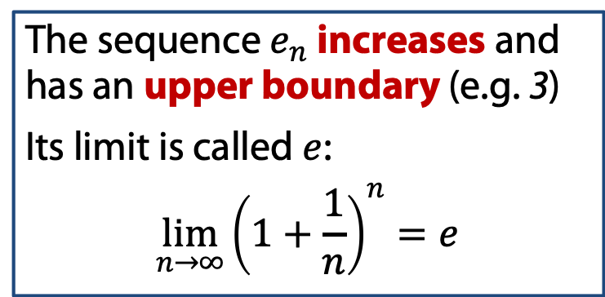
Limits of sequence: definition of e
Consider the following sequence:
$$e_{n}={\left(1+\frac{1}{n}\right)}^{n}$$
Does it have a limit?
Monotone convergence theorem: if a sequence increases and has an upper boundary, then it converges.
Same applies for the case of decreasing sequence with lower boundary.
The sequence $e_{n}$ increases and has an upper boundary (e.g. 3)
Its limit is called $e$: $$\lim_{n→∞}{{\left(1+\frac{1}{n}\right)}^{n}=e}$$

Slide 73
The indeterminate forms

Slide 74
Limits of sequence: the indeterminate forms
Sometimes the direct application of the arithmetic rules to the limit may result in some frightening cases.

Slide 75
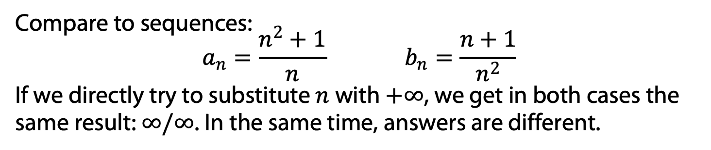
Limits of sequence: the indeterminate forms
Sometimes the direct application of the arithmetic rules to the limit may result in some frightening cases.
Compare to sequences:
$$a_{n}=\frac{n^{2}+1}{n} b_{n}=\frac{n+1}{n^{2}}$$
If we directly try to substitute $n$ with $+∞$, we get in both cases the same result: $∞/∞$. In the same time, answers are different.

Slide 76
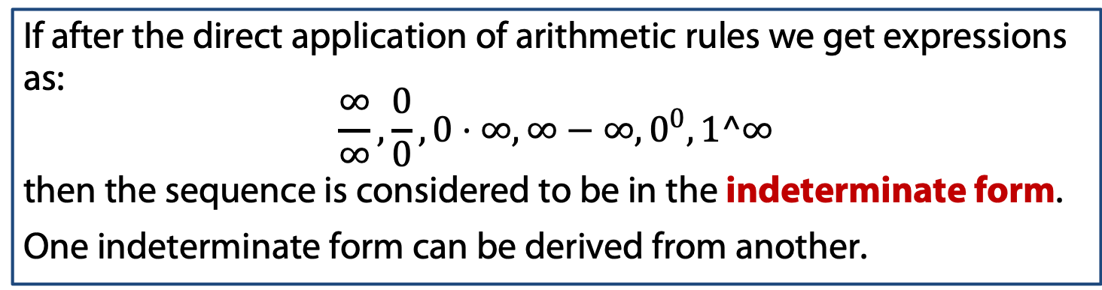
Limits of sequence: the indeterminate forms
Sometimes the direct application of the arithmetic rules to the limit may result in some frightening cases.
Compare to sequences:
$$a_{n}=\frac{n^{2}+1}{n} b_{n}=\frac{n+1}{n^{2}}$$
If we directly try to substitute $n$ with $+∞$, we get in both cases the same result: $∞/∞$. In the same time, answers are different.
If after the direct application of arithmetic rules we get expressions as:
$$\frac{∞}{∞},\frac{0}{0}, 0⋅∞, ∞−∞, 0^{0}, 1^∞$$
then the sequence is considered to be in the indeterminate form.
One indeterminate form can be derived from another.

Slide 77
Limits of sequence: the indeterminate forms
Sometimes the direct application of the arithmetic rules to the limit may result in some frightening cases.
Compare to sequences:
$$a_{n}=\frac{n^{2}+1}{n} b_{n}=\frac{n+1}{n^{2}}$$
If we directly try to substitute $n$ with $+∞$, we get in both cases the same result: $∞/∞$. In the same time, answers are different.
If after the direct application of arithmetic rules we get expressions as:
$$\frac{∞}{∞},\frac{0}{0}, 0⋅∞, ∞−∞, 0^{0}, 1^∞$$
then the sequence is considered to be in the indeterminate form.
One indeterminate form can be derived from another.
The appearance of the indeterminate forms does not give an answer! It only implies necessity of further transformations!

Slide 78
Limit of recurrence sequences

Slide 79
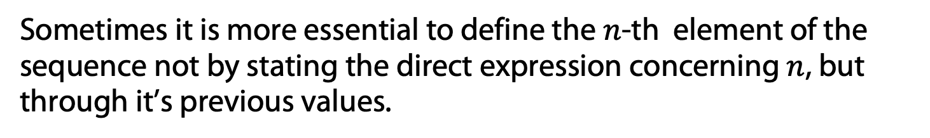
Limits of recurrence sequence
Sometimes it is more essential to define the $n$-th element of the sequence not by stating the direct expression concerning $n$, but through it’s previous values.

Slide 80
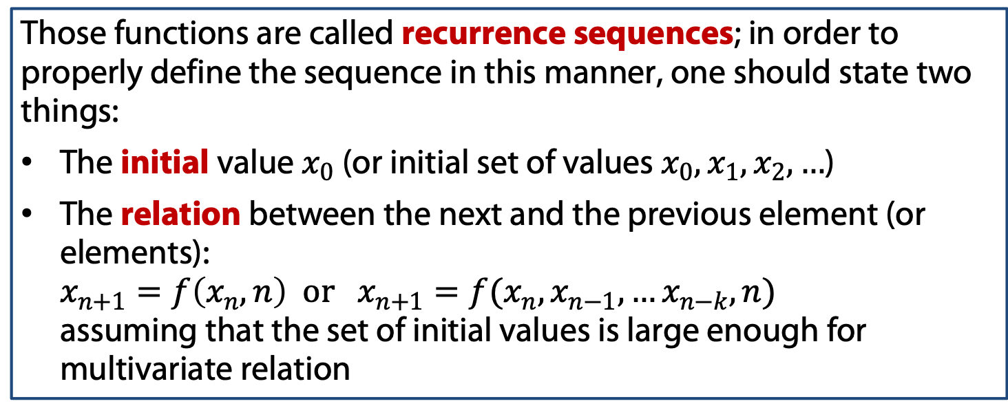
Limits of recurrence sequence
Sometimes it is more essential to define the $n$-th element of the sequence not by stating the direct expression concerning $n$, but through it’s previous values.
Those functions are called recurrence sequences; in order to properly define the sequence in this manner, one should state two things:
The initial value $x_{0}$ (or initial set of values $x_{0},x_{1},x_{2},…$)
The relation between the next and the previous element (or elements): $x_{n+1}=f\left(x_{n}, n\right) or x_{n+1}=f(x_{n},x_{n−1},…x_{n−k},n)$ assuming that the set of initial values is large enough for multivariate relation

Slide 81
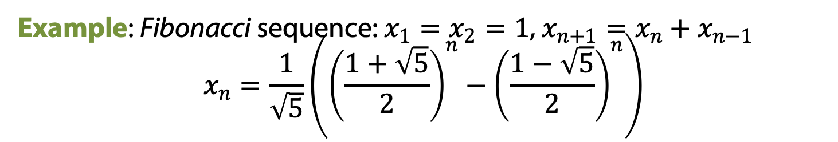
Limits of recurrence sequence
Sometimes it is more essential to define the $n$-th element of the sequence not by stating the direct expression concerning $n$, but through it’s previous values.
Those functions are called recurrence sequences; in order to properly define the sequence in this manner, one should state two things:
The initial value $x_{0}$ (or initial set of values $x_{0},x_{1},x_{2},…$)
The relation between the next and the previous element (or elements): $x_{n+1}=f\left(x_{n}, n\right) or x_{n+1}=f(x_{n},x_{n−1},…x_{n−k},n)$ assuming that the set of initial values is large enough for multivariate relation
Example: Fibonacci sequence: $x_{1}=x_{2}=1$, $x_{n+1}=x_{n}+x_{n−1}$
$$x_{n}=\frac{1}{\sqrt{5}}\left({\left(\frac{1+\sqrt{5}}{2}\right)}^{n}−{\left(\frac{1−\sqrt{5}}{2}\right)}^{n}\right)$$

Slide 82
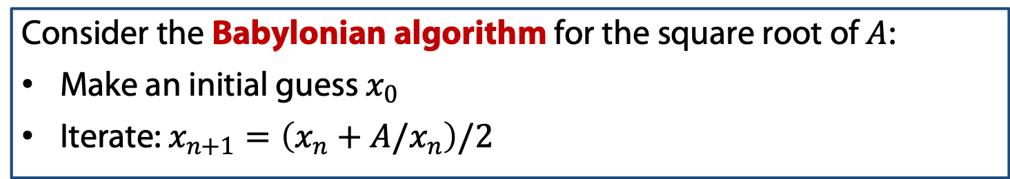
Limits of recurrence sequence
Since we established the idea of those sequences, one should assume that there should be a way to find its limits other than finding the direct relation.
Consider the Babylonian algorithm for the square root of $A$:
Make an initial guess $x_{0}$
Iterate: $x_{n+1}=\left(x_{n}+A/x_{n}\right)/2$

Slide 83

Limits of recurrence sequence
Since we established the idea of those sequences, one should assume that there should be a way to find its limits other than finding the direct relation.
Consider the Babylonian algorithm for the square root of $A$:
Make an initial guess $x_{0}$
Iterate: $x_{n+1}=\left(x_{n}+A/x_{n}\right)/2$
Let us take a limit of both sides of this relation:
$$\lim_{n→∞}{x_{n+1}}=\lim_{n→∞}\left(x_{n}+A/x_{n}\right)/2$$
By arithmetic rules and the idea: $\lim_{n→∞}{x_{n+1}}=\lim_{n→∞}{x_{n}}=C$ we get an equation:
$$C=\frac{1}{2}\left(C+\frac{A}{C}\right)$$

Slide 84

Limits of recurrence sequence
Since we established the idea of those sequences, one should assume that there should be a way to find its limits other than finding the direct relation.
Consider the Babylonian algorithm for the square root of $A$:
Make an initial guess $x_{0}$
Iterate: $x_{n+1}=\left(x_{n}+A/x_{n}\right)/2$
Let us take a limit of both sides of this relation:
$$\lim_{n→∞}{x_{n+1}}=\lim_{n→∞}\left(x_{n}+A/x_{n}\right)/2$$
By arithmetic rules and the idea: $\lim_{n→∞}{x_{n+1}}=\lim_{n→∞}{x_{n}}=C$ we get an equation:
$$C=\frac{1}{2}\left(C+\frac{A}{C}\right)$$
So, we found two “limits”: $C=±\sqrt{A}$. But which one is correct and is there a correct one?

Slide 85



Limits of recurrence sequence
Let us revisit what we done previously:
$$\lim_{n→∞}{x_{n+1}}=\lim_{n→∞}{x_{n}}=C$$
Formally this statement should start with the phase ”if there is a limit then”. In other words, we additionally assumed the existence of the limit!
Consider the following series:
$$S_{n}=1−1+1−1+1−…+{\left(−1\right)}^{n−1}$$
Since all odd elements of it equal to $1$ and evens are $0$, then this sequence does not converge.
In the same time we can rewrite it as a recurrence one:
$$S_{1}=1, S_{n+1}=1−S_{n}$$
Then, by taking a limit of both sides, we get:
$$C=1−C ⟹ C=1/2$$

Slide 86
Limits of recurrence sequence
Let us revisit what we done previously:
$$\lim_{n→∞}{x_{n+1}}=\lim_{n→∞}{x_{n}}=C$$
Formally this statement should start with the phase ”if there is a limit then”. In other words, we additionally assumed the existence of the limit!

Slide 87

Limits of recurrence sequence
In other words, before we march further with our answer for the Babylonian square root, we need to prove that there is a limit for this sequence.
We are going to use the same monotone convergence theorem as we did for the definition of e.
Thus in order to prove convergency, we need to prove that the sequence is bounded and monotonic.
Say we are working with $S=2$ and $x_{0}=2$. Let’s show that $x_{n}>\sqrt{2}$

Slide 88

Limits of recurrence sequence
In other words, before we march further with our answer for the Babylonian square root, we need to prove that there is a limit for this sequence.
We are going to use the same monotone convergence theorem as we did for the definition of e.
Thus in order to prove convergency, we need to prove that the sequence is bounded and monotonic.
Now we are going to show its monotony: $x_{n+1}<x_{n}$

Slide 89
Introduction: numerical sets, functions, limits

